Slide 1
Why you should never visit Slovakia. Ever.
29 reasons : )!

Slide 2
1. Slovakia is really not beautiful

Slide 3
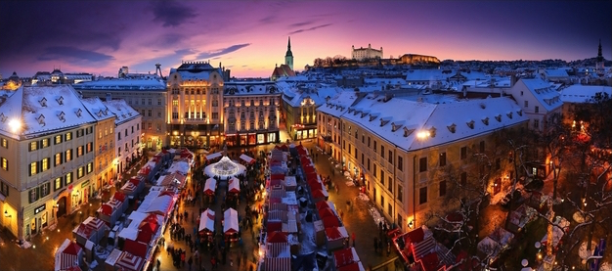
Bratislava Main Square, Christmas market

Slide 4
2. Especially not the nature

Slide 5
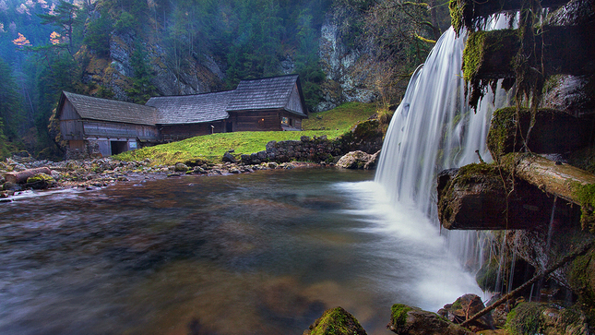
Mill in Kvačianska Valley

Slide 6
3. It has literally nothing to offer

Slide 7
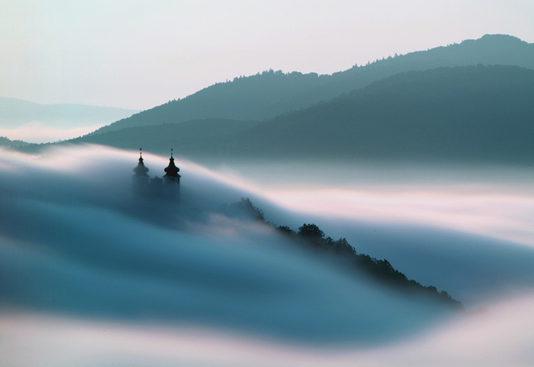
Banská Štiavnica Calvary

Slide 8
4. No breathtaking places

Slide 9
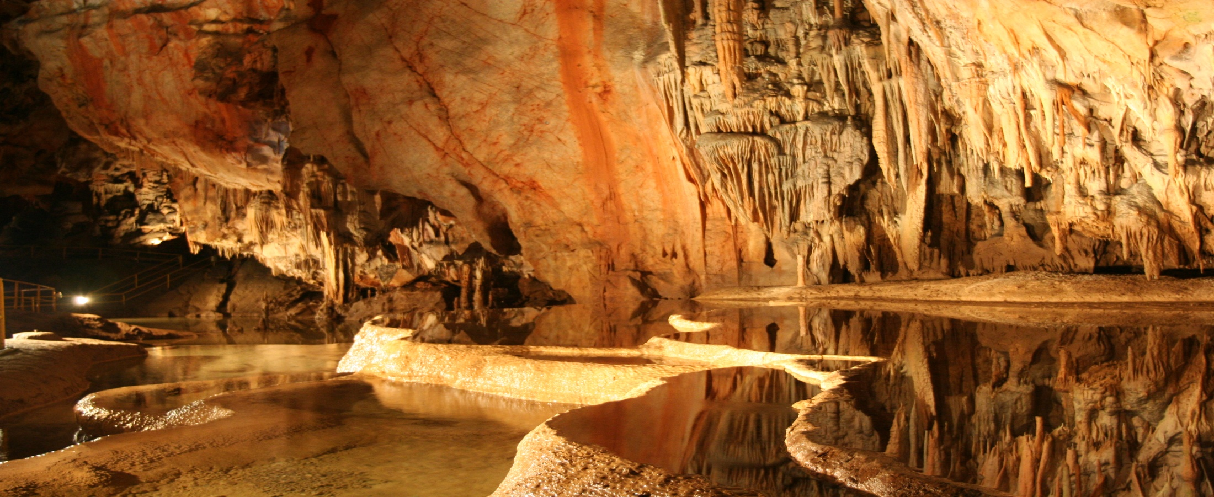
Domica cave, Rožňava

Slide 10
5. No history

Slide 11
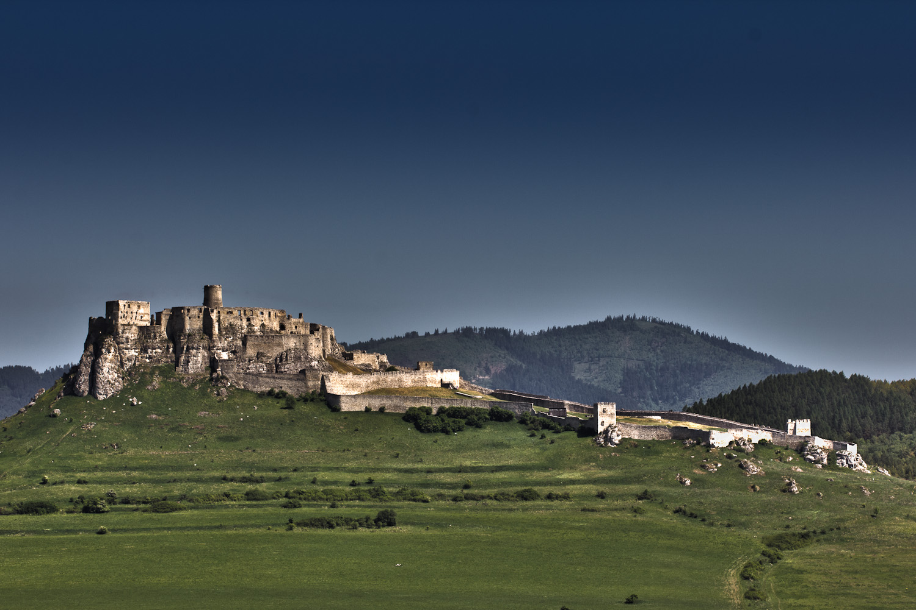
Spiš castle, the 6th biggest castle in the world

Slide 12
6. And definitely no beautiful landscapes

Slide 13
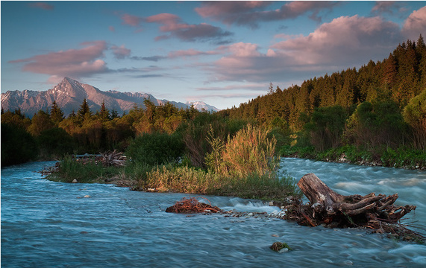
The High Tatras

Slide 14
7. Beautiful animals live only in the ZOOs

Slide 15
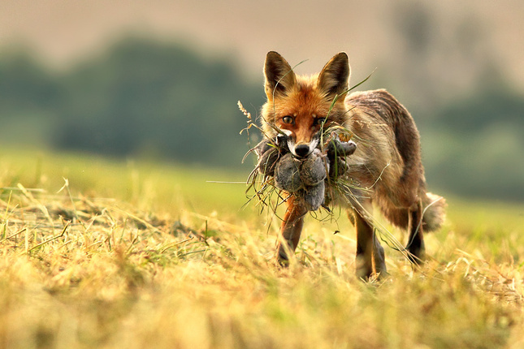
A wild fox, Pieniny

Slide 16
8. Because the country doesn't have its traditional ones

Slide 17
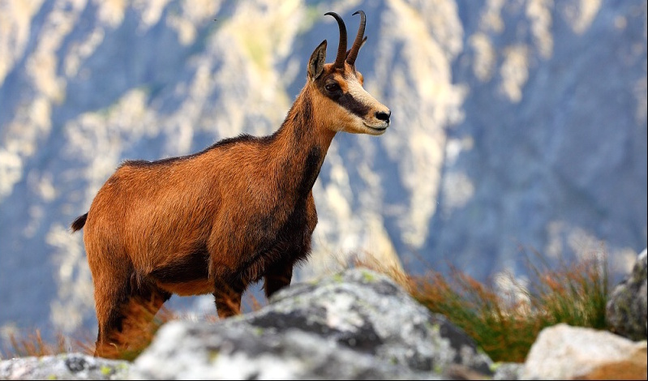
Tatra Chamois, which is living only in the Tatras

Slide 18
9. The countryside is so boring

Slide 19
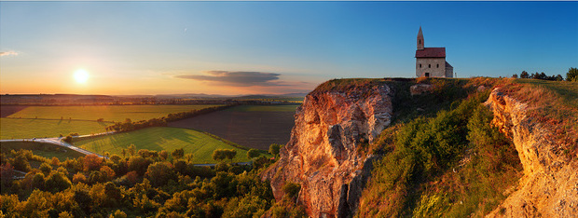
A small church in Drážovce, Nitra

Slide 20
10. And gets even more boring in the winter

Slide 21
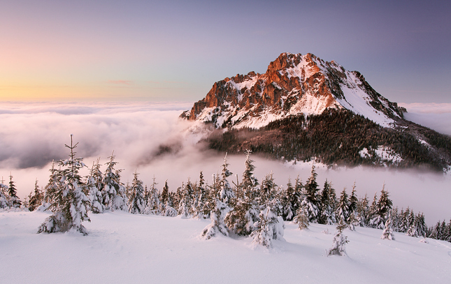
Veľký Rozsutec mountain, Žilina

Slide 22
11. Not to mention the spring, of course

Slide 23
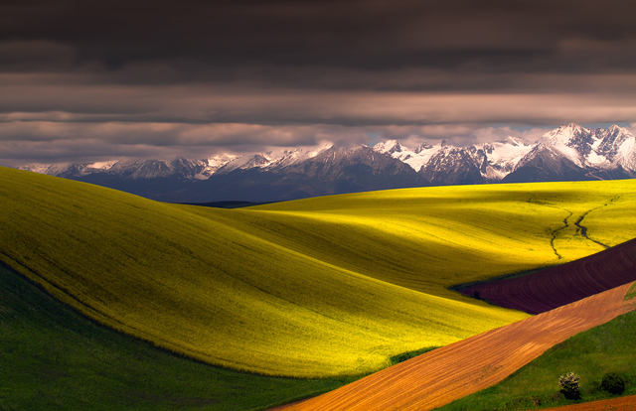
The High Tatras

Slide 24
12. It sucks since the country doesn't have a sea

Slide 25
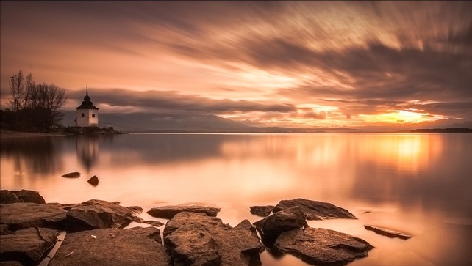
The Liptov Dam, Liptovský Mikuláš

Slide 26
13. And it has no traditions...

Slide 27
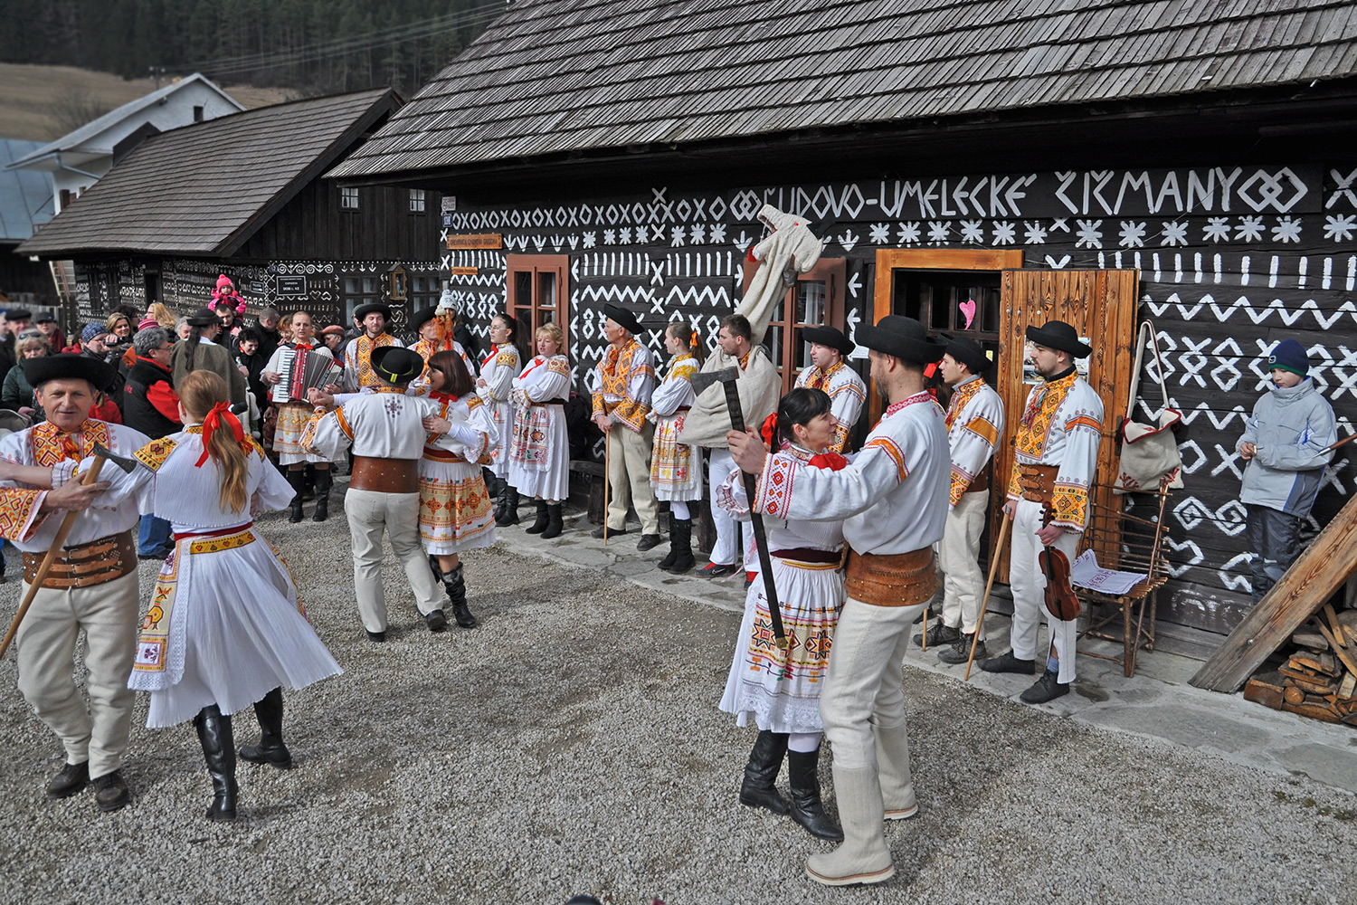
A traditional slovak festival, Čičmany

Slide 28
14. ...nor interesting museums

Slide 29
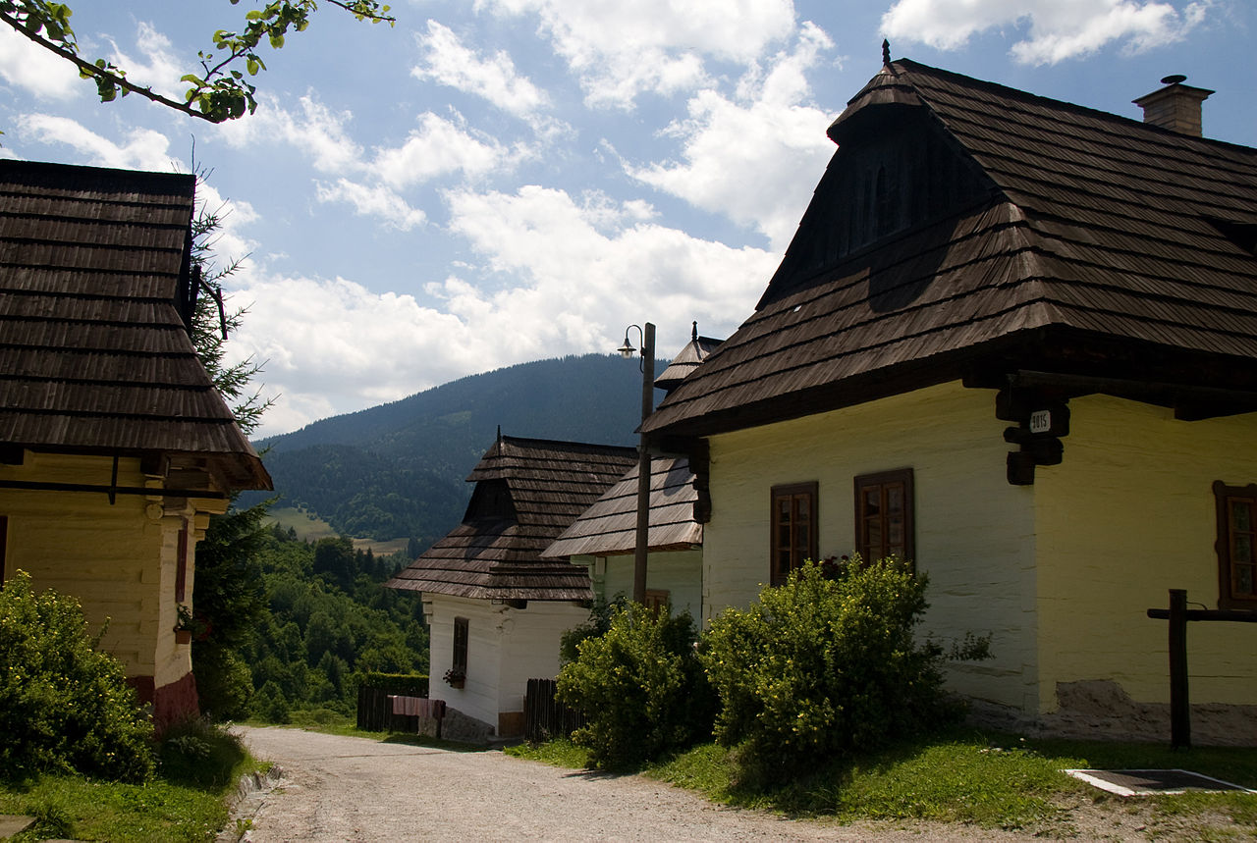
Vlkolínec museum - a traditional vilage,World Heritage site, Ružomberok

Slide 30
15. It just grew out of nothing

Slide 31
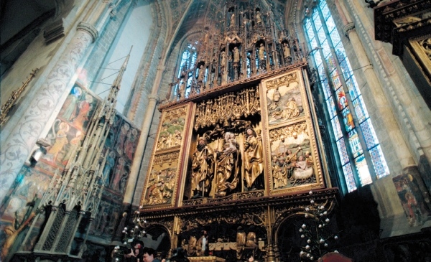
The Altar of Master Paul of Levoča, 16th century, the biggest wooden altar in the world

Slide 32
16. The cities are just so ugly!

Slide 33
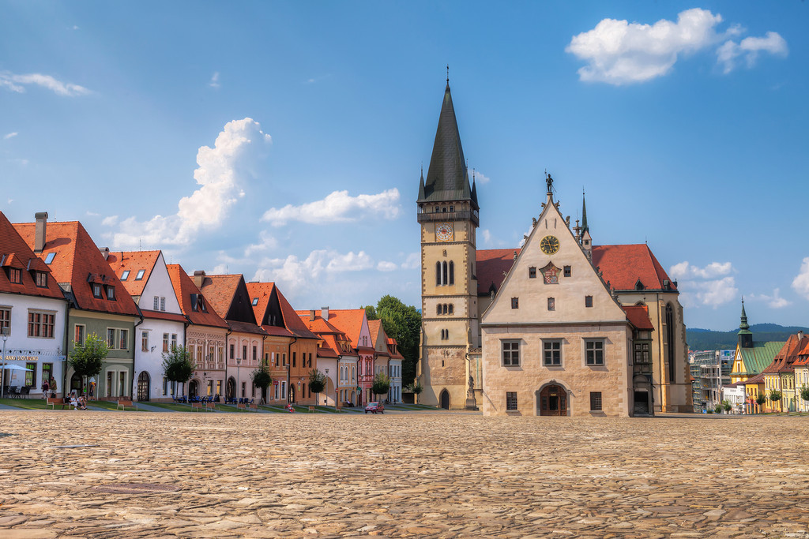
Unesco World Heritage, Bardejov

Slide 34
17. Not interesting at all

Slide 35
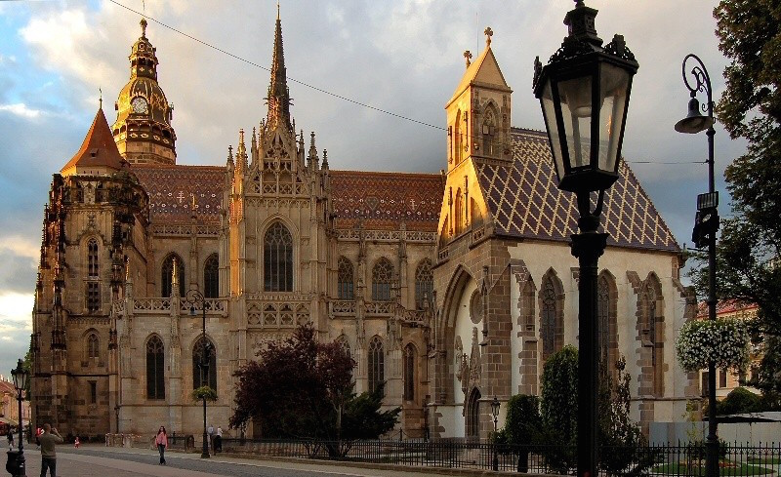
St. Elisabeth's Cathedral, Košice

Slide 36
18. You can just feel the communism everywhere

Slide 37
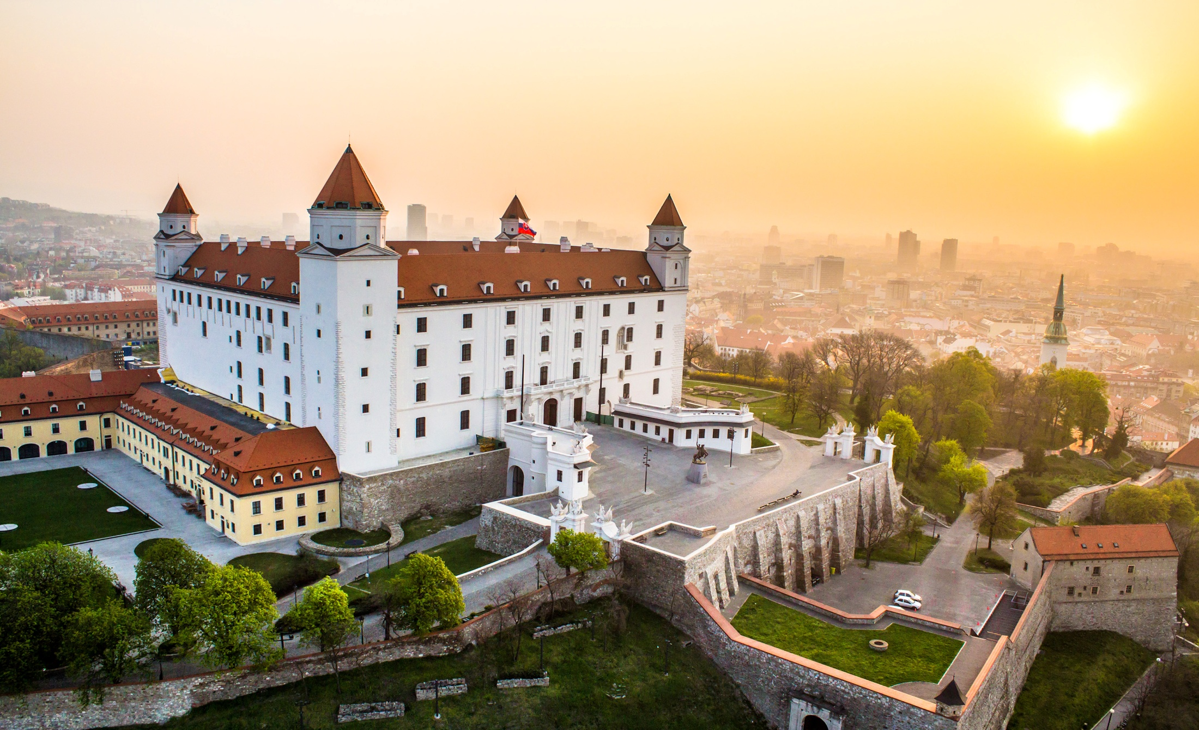
Bratislava Castle, Bratislava

Slide 38
19. Really nothing to see

Slide 39
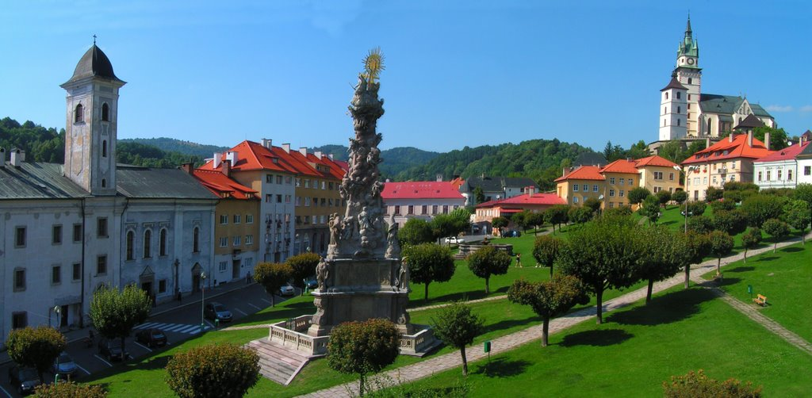
Main Square, Kremnica, one of the oldest Mints in the world

Slide 40
20. Especially not in Bratislava. Everyone hates Bratislava. You too. Start hating. Now.

Slide 41
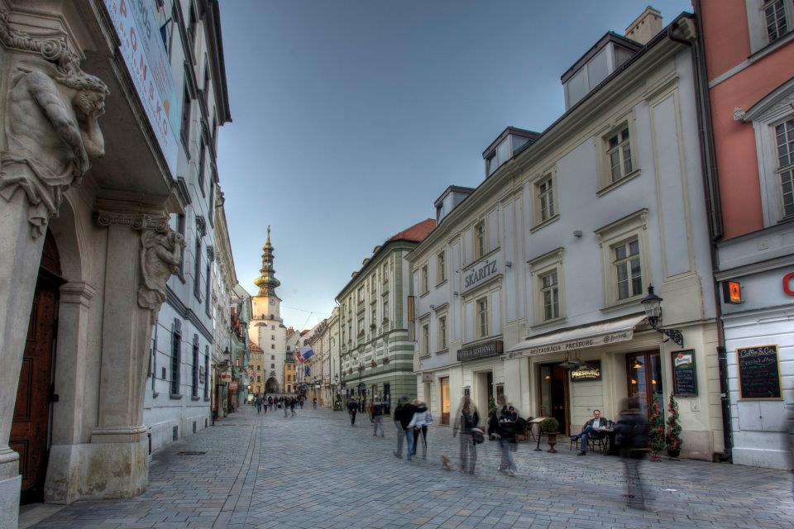
Bratislava's Old Town with an overview of the St. Michael's Gate, a former part of the city's fortification

Slide 42
21. And by the way - the country has really terrible castles...Terrible!

Slide 43
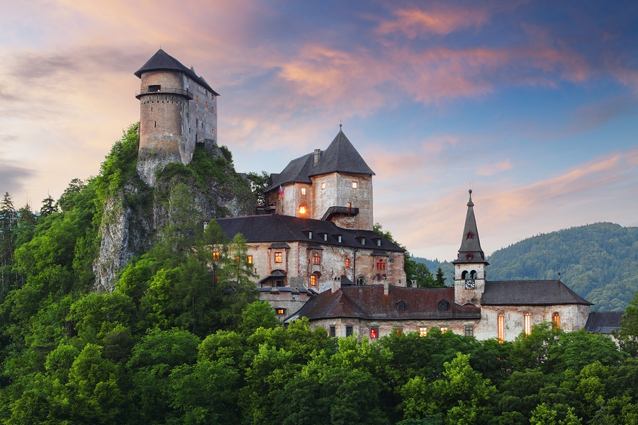
Orava Castle, Oravský Podzámok

Slide 44
22. Just ugly

Slide 45
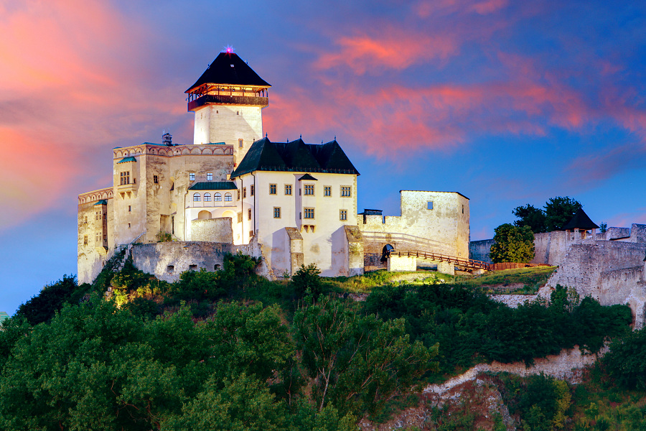
Trenčín Castle, Trenčín

Slide 46
23. Mainly this one

Slide 47
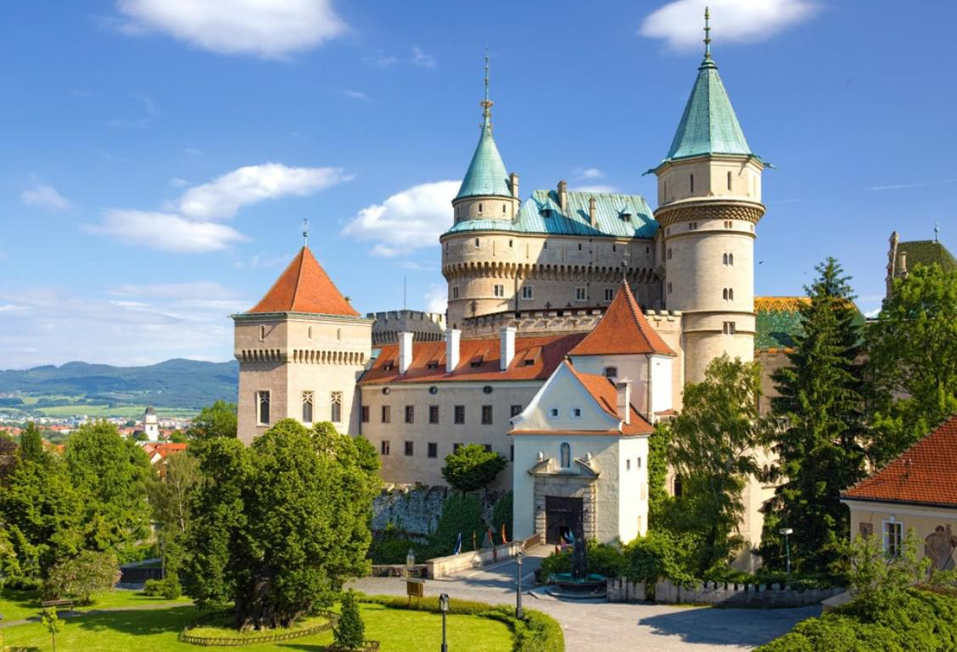
Bojnice Castle, Bojnice

Slide 48
24. As well as the women...

Slide 49
Lomnický Štít, High Tatras

Slide 50
25. ...and the food

Slide 51
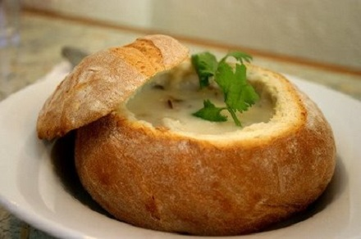
A traditional slovak garlic soup served in a crispy bread

Slide 52
26. Really bad

Slide 53
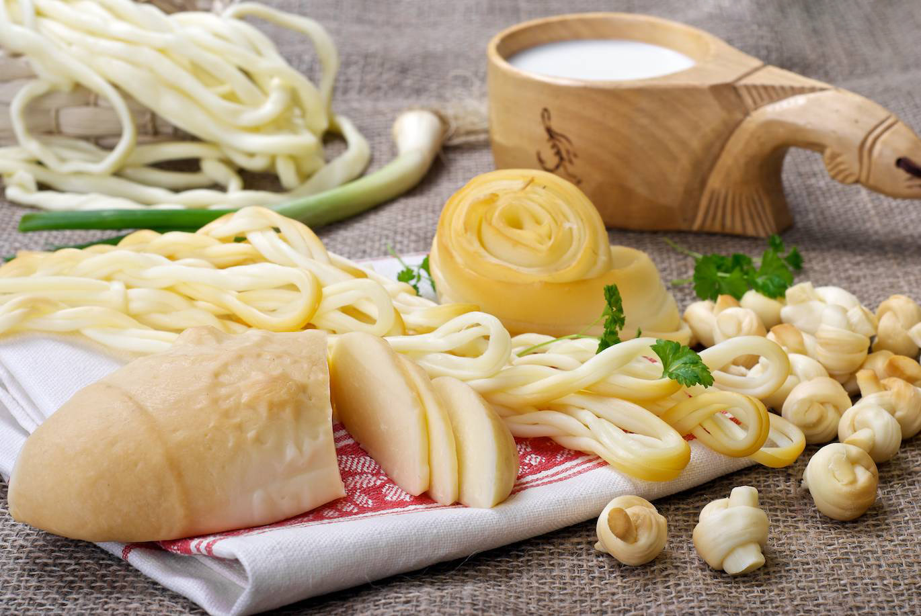
Traditional slovak types of cheese, such as Oštiepok, Korbáčik or Parenica

Slide 54
27. Everything is just boring, sad and ugly

Slide 55
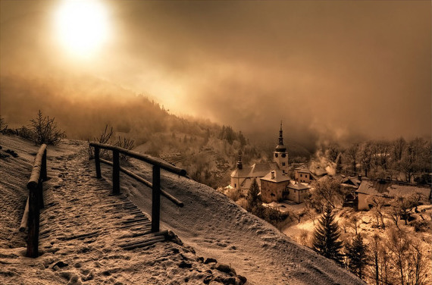
Špania Dolina, a Valley in Banská Bystrica

Slide 56
28. They will all just rob you anyway...even the animals

Slide 57
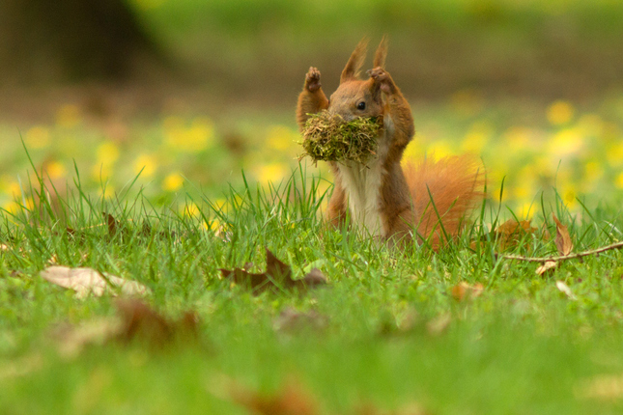
A squirrel in a park, Nitra

Slide 58
29. There is no point in visiting Slovakia...Why anyone does it?

Slide 59
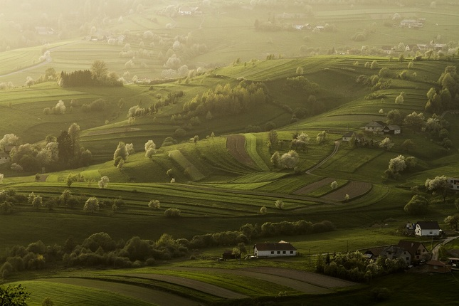
Hriňová, Detva

