Slide 1
Visegrad: cooperation, fund and study
13th Visegrad Summer School Cracow 11 July 2014

Slide 2
The Path to Visegrád…
1986–1990: Tensions ease between the East and West, Cold War coming to an end; increasing demand for a direct, regional cooperation between some countries
1989: “Quadragonale” established between Austria, Hungary, Yugoslavia, and Italy*, + Czechoslovakia (CS) = “Pentagonale” (1990), + Poland (PL) = “Hexagonale” (1992); later transformed into current Central European Initiative** (18 members)
1990: “Bratislava Meeting” initiated by V. Havel: CS + HU + PL (+ YU, IT, AT)
http://www.visegradgroup.eu/about/history
2
Notes:
*WP, NATO members, neutral and Non-Aligned countries
**CEI http://www.cei.int/

Slide 3
The Path to Visegrád…
1989: December - first of regular meetings of CS + HU + PL ministers of foreign affairs:
How the three countries could support each other in dismantling the Soviet empire, transforming our countries politically and economically, and integrating with the institutions of the developed world?
J. Dienstbier
1990: The first success in the cooperation—departure of Soviet troops, dissolution of the Warsaw Pact (1991) led to the formalization of the cooperation
Nov. 1990: J. Antall suggests (OSCE Paris) a follow-up to Bratislava Meeting to take place in Visegrád*
http://www.visegradgroup.eu/about/history
3
Notes:
* Mazowiecki suggested Krakow

Slide 4
The Path to Visegrád…
Jan. 21, 1991: CS, HU and PL MFAs decide to achieve the “quickest dissolution of the Warsaw Pact” and to work together to negotiate all association agreements with the European Community
Feb. 15, 1991: Summit meeting of the “troika” (V3) in Budapest; later on, Visegrad Declaration signed in Visegrád
Visegrád was selected by J. Antall as a symbolic re- connection to the royal peace and economic talks among Charlers Robert of Anjou, John of Luxembourg, and Casimir III in Visegrád in 1335/1336
http://www.visegradgroup.eu/documents/essays-articles/visegrad-1335
4

Slide 5
The Path to Visegrád…
Oct. 1991: 2nd V3 summit in Cracow
May 1992: 3rd (last) V3 summit in Prague (CS → CZ + SK on Jan. 1, 1993)
1993–1998: cooperation slows after the split of CS and due to the prevalence of individual efforts towards the Euro-Atlantic integration*
Oct. 1998: Budapest Summit: PMs of CZ + HU + PL express support for revitalization of the cooperation
May 1999: Bratislava Summit (formal comeback): approval of “Contents of Visegrad Cooperation”
June 2000: International Visegrad Fund established (Štiřín)
http://www.visegradgroup.eu/about/cooperation
5
Notes:
*1993–1998: cooperation slackens, no PM summits, only ministerial meetings, except for V4 (PMs, Heads of States) + Clinton in Prague on 11–12 January 1994

Slide 6
Visegrad Fund: Basic Characteristics
V4’s only solid organization to date
international organization accredited with SK MFA
equal rights of V4 states:
annual rotating presidency (January–December) (presidencies in the group: July–June)
rotating management (3-year missions)
consensus in decision-making
equal contributions of V4 states (€2M p.a.)
external funding (NL, US, SE, CH…)
2-member management + 13-member staff (+ interns)
www.visegradfund.org
6

Slide 7
The Fund’s Main Aims
(financial) support of movement of people and ideas
strengthening of the internal cohesion of the region
weakening of historical animosities and awareness-building
instrument of joint V4 foreign policy (since 2004):
support of transfer of know-how from the region to the Western Balkans and Eastern Partnership countries (20% of overall funding in 2013)
program priorities defined by the group (Strategic Grants, Visegrad+, V4EaP program chapter)
key leverages: grant programs + “mobilities” (scholarships, fellowships, artist residencies)
www.visegradfund.org/about
7

Slide 8
Program Overview
Academic and Mobility Programs | Grant Programs
Visegrad Scholarship Program: | Small Grants
Intra-Visegrad, In-Coming, Out-Going | Standard Grants
Visegrad Artist Residency Program (VARP): | Visegrad Strategic Grants
VARP—Visual & Sound Arts | Visegrad Strategic Conferences
VARP—Performing Arts | Visegrad+ (Western Balkans)
Visegrad Literary Residency Program | Visegrad 4 Eastern Partnership Program:
VARP in New York | Flagship Projects
Visegrad University Studies Grants | V4EaP (Extended) Standard Grants
Visegrad–Taiwan Scholarships | V4EaP Visegrad University Studies Grants
Visegrad Scholarships at OSA | IVF–NSC Taiwan Joint Research Projects
www.visegradfund.org/scholarships, …/residencies
www.visegradfund.org/grants
8

Slide 9
Grant Project Categories: Small/Standard Grants
cultural cooperation (47%)
scientific exchange and research (20%)
education (15%)
youth exchanges (10%)
cross-border cooperation (7%)
promotion of tourism (2%)
100% = 3,911 grant projects approved in 2000–2013
www.visegradfund.org/grants
9

Slide 10
Basic Grant Principles
projects must have “Visegrad added value”
projects involve entities from at least 3 V4 countries*
grants cover about 80% project costs (e.g. 70% w/in Strategic Grants, 100% w/in Strategic Conferences)
reimbursements in tranches with advance payments (up to 80% of project costs)
15% overhead costs
costs documented through copies of invoices and bills
only a single project per applicant* (multiple project-partnerships possible)
* Strategic Grants, Visegrad+ projects and the V4EaP chapter are exceptions
www.visegradfund.org/grants/guidelines
10

Slide 11
Overview—Basic Grant Programs
 | Small Grants | Standard Grants | Strategic Grants
Project budget | < €6,000 | > €6,001 (ca. €13,000 on average) | €40,000 (on average)
Max. IVF share | 80% | 80% | 70%
Timeframe | 6 months | 12 months | 12–36 months
Cash limit | 50% | 30% | 20%
Overheads | 15% | 15% | 15% (+ 7% tangible/intangible assets)
Evaluation | 50 working days | 60 working days | 50 working days
Deadlines | March 1, June 1, Sept. 1, Dec. 1 | March 15, Sept. 15 | April 15
www.visegradfund.org/grants/guidelines
11

Slide 12
Who Can Apply?
majority of applicants are CSOs and other NGOs
primary/secondary schools, colleges + universities
municipalities, regional governments
other public institutions (museums, galleries, sports clubs)
individual citizens or even private companies
not organizations fully funded from state budgets or state administration institutions (ministries, cultural institutes, etc.)
www.visegradfund.org/grants/guidelines
12

Slide 13
What Cannot Be Refunded?
tangible/intangible assets (with the exception of 7% allowed within Strategic Grants)
indirect costs (utilities, bills…) exceeding 15% overhead costs
internal costs and expenses exceeding 15% overhead costs
employments ruled by labor code (and related costs, such as per diems)
www.visegradfund.org/grants/guidelines
13

Slide 14
What Can Be Refunded?
printing and publishing costs
website design and updates
rent of premises
expert fees and honoraria
accommodation and board
translation and interpreting
awards and prizes
advertising and promotional costs
office supplies, etc.
www.visegradfund.org/grants/guidelines
14

Slide 15
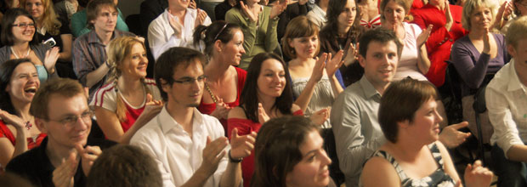
Visegrad University Studies Grants
support for the development and launching of outstanding university-level courses or degree programs that explicitly deal with the Visegrad region
any accredited higher-level institution worldwide is eligible for support
grants: ca. €10,000/course, and ca. €40,000/degree program
deadline: November 10
www.visegradfund.org/vusg
15

Slide 16
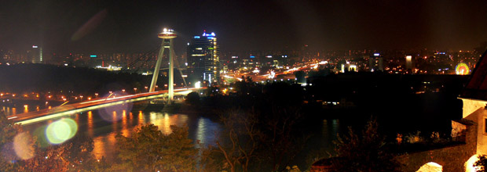
Visegrad Scholarship Program
support of individual mobility on MA/post-MA levels
involving the V4 region + the Western Balkans + EaP
support for both scholars and host institutions: €2,300/semester + €1,500/semester (+ travel grants)
accredited public/private colleges and universities + + science academies can host scholars
no age limit
annually ca. 400 semesters
annual deadline: January 31
www.visegradfund.org/scholarships
16

Slide 17
Visegrad Artist Residency Programs
Visual & Sound Arts
individual 3-month residencies, funding both the artists and the host institution
€4,500/project (€2,250 + €2,250)
Performing Arts (with Truc Sphérique/Stanica Žilina-Záriečie)
supporting innovation, experiment and creativity in new drama, contemporary dance, new circus, physical theatre, visual theater, alternative theater, performance art
€4,000/€8,000 per individual/group project
Residencies in New York (with Futura Prague and Triangle Arts Assn.)
Individual 3-month residencies for visual artists in Brooklyn, NY
€4,000 scholarships + free accommodation
Literary Residencies (with Villa Decius Cracow)
mobility for fiction/non-fiction writers, poets, essayists, critics, translators and journalists
16 people for 3 months + 16 people for 6 weeks
€750/month + accommodation and work space
www.visegradfund.org/residencies
17

Slide 18
est. in 2011 by V4 PMs at a summit in Bratislava with the aim to enhance the cooperation between the V4 region and the Eastern Partnership countries (Armenia, Azerbaijan, Belarus, Georgia, Moldova, and Ukraine)
program co-funded by grants from the governments of the Netherlands, Sweden, Switzerland, and U.S.
V4EaP operates grant and mobility programs:
Flagship Projects
Extended Standard Grants
Visegrad University Studies Grants—EaP
Visegrad Scholarships for EaP
www.visegradfund.org/east
18

Slide 19
Visegrad+ (Western Balkans)
annual budget €400,000
targeting links between the Western Balkan and Visegrad regions
support of longer-term, bigger-scale proposals
average support ca. €65,000
main topics: transformation, transparency and anti-corruption, good governance, justice and security, conflict resolution, capacity building within civil society, etc.
www.visegradfund.org/plus
19

Slide 20
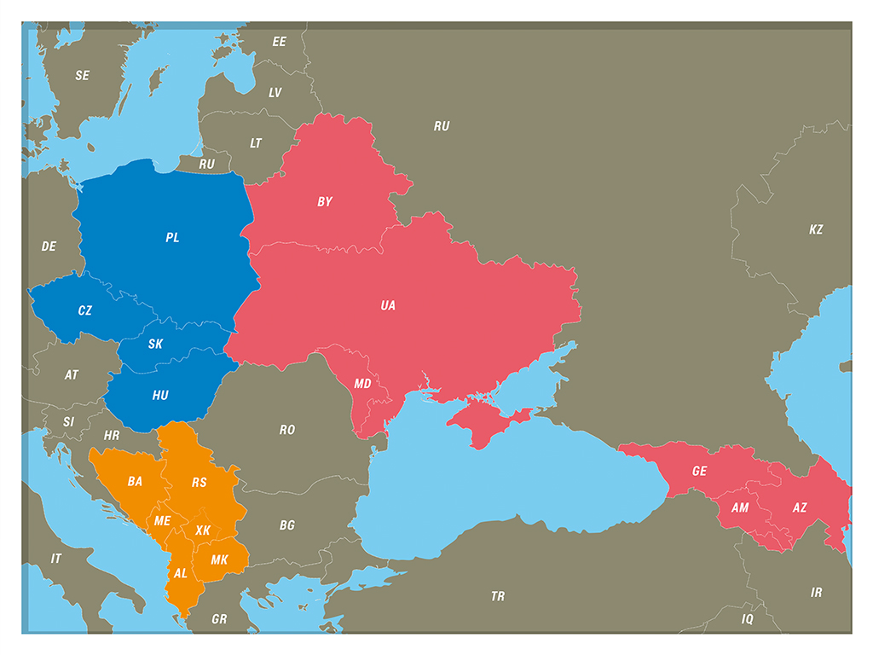

Slide 21
Funding by Recipient Regions (2000–2013)
100% = €53,857,877
21

Slide 22
Eastern Partnership Countries (2004–2013)
100% = €5,613,160 (= 10.42% of total funding)
22

Slide 23
The Western Balkans (2004–2013)
* This designation is without prejudice to positions on status, and is in line with UNSC 1244 and the ICJ Opinion on the Kosovo Declaration of Independence.
100% = €1,115,815 (= 2.00% of total funding)
23

Slide 24
Main Results
stable and visible component of V4 cooperation
stronger level of regional cooperation and cooperation with neighboring regions
good promotion of the region in the EU
to date (by the end of 2013):
more than 4,000 grant projects
over 2,000 “mobilities” (scholarships/residencies)
total worth of ca. €54 million
www.visegradfund.org/about
24

Slide 26
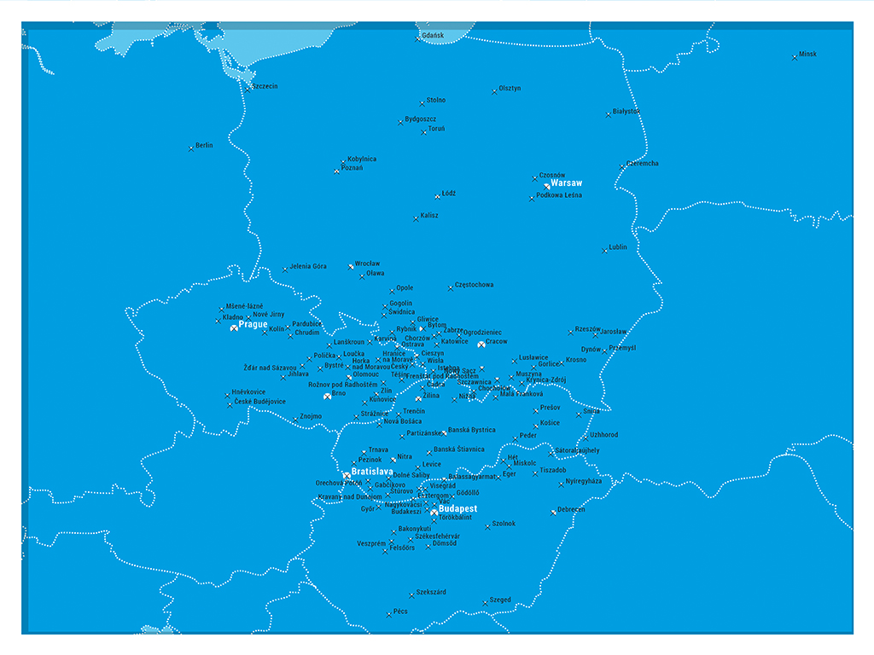

Slide 27
Thank you for your attention.
György Varga
Deputy Executive Director E: varga@visegradfund.org T: +421 259 203 811, -802 F: +421 259 203 805

