Slide 1
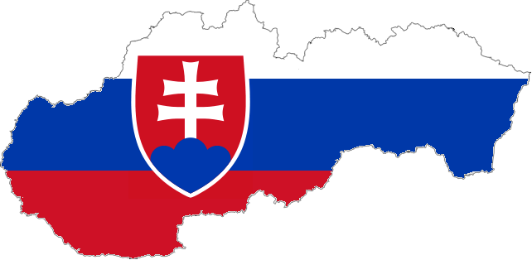
Slovakia QUIZ

Slide 2
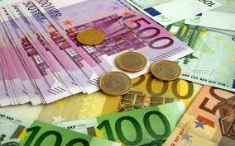
How much is the minimum wage per hour in Slovakia?
1, 192 €
1, 193 €
2, 184 €
2, 769 €

Slide 3
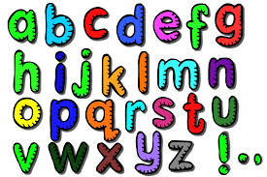
Which line does contain letters of Slovak alphabet only?
ä, ô, ž, č, ch
w, ř, ô, č, ď
ä, ň, ľ, ę, ç
w, ď, ű, ł, č

Slide 4
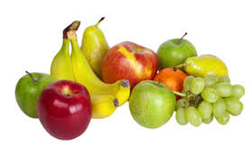
What does Slovak word „čučoriedka“ mean?
Strawberry
Blackberry
Blueberry
Raspberry

Slide 5
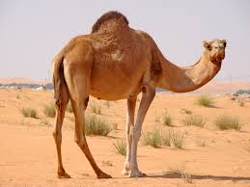
How do the Slovaks say “camel“?
ťava
čižma
lopúch
púštna koza

Slide 6
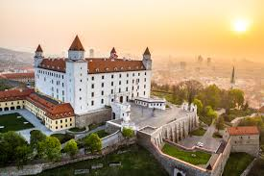
Which of these cities is not located in Slovakia?
Havaj
Praha
Rajka
Chorvátsky Grob
Alekšince

Slide 7
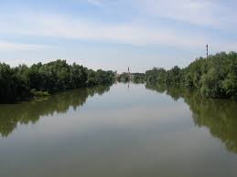
What is the name of the longest Slovak river?
Váh
Hron
Ipeľ
Torysa
Danube

Slide 8
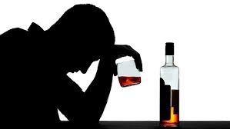
An average Pole drinks 13,25 litres of alcohol per year. How much alcohol does an average Slovak drink?
A) 15, 12 l
B) 11, 86 l
C) 13, 33 l
D) 5, 23 l

Slide 9
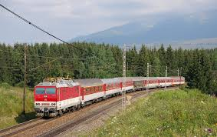
How much does a student’s train ticket from Bratislava to Košice cost?
5, 12 €
14, 32 €
22, 92 €
0 €
1 €

Slide 10
What never happened in the Slovak Parliament?
A woman tried to throw a chair on the MPs
B) Several members of the Parliament added a pornstar on the Facebook
C) A member of the parliament told another „You will end up in the jail, you bastard!“ and later lied he hadn´t said it even thought it was recorded on a tape
D) An MP brought marihuana to the Parliament to show how accessible it is; later he got arrested.

Slide 11
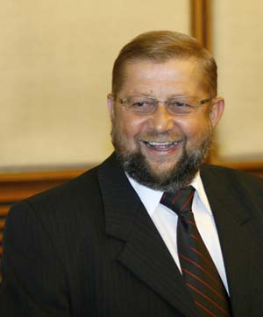
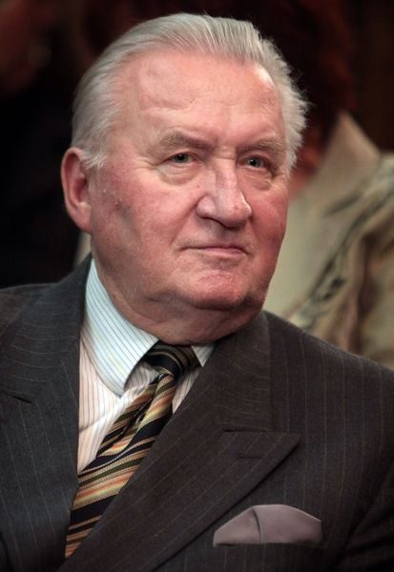
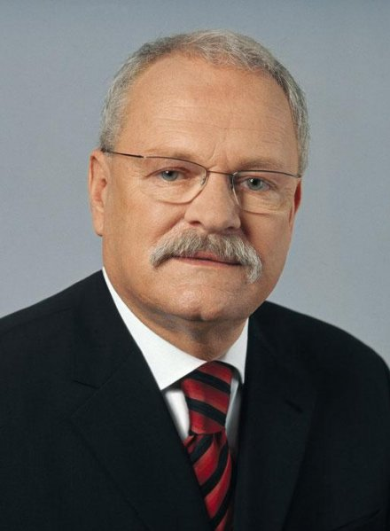
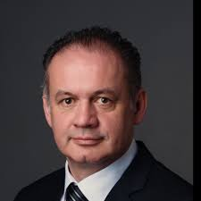
Who was never Slovak President?
Štefan Harabin
Andrej Kiska
Ivan Gašparovič
Michal Kováč

Slide 12
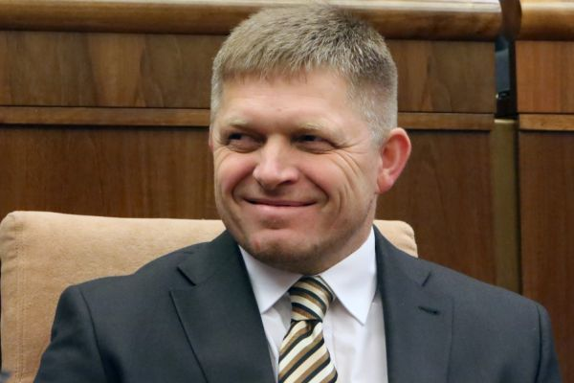
How many push-ups is the Slovak PM able to do in 30 minutes?
599
99
999
1001

Slide 13
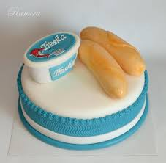
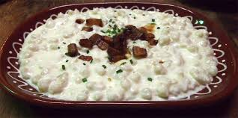
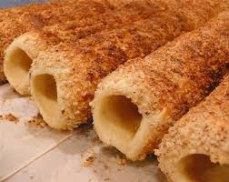
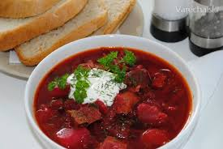
Which of these dishes is not Slovak?
Treska s rožkom
Bryndzové halušky
Skalický trdelník
Červený boršč

