Slide 1
Attila Papp Z.
Roma population
14. Visegrad Summer School
Krakow, July, 2015

Slide 2
Content
Who is Roma?
Origins, short history of Romani people
Data, facts about Roma and the „Roma question”
Roma in Hungary
European perspective
Conclusions, final messages

Slide 3
Who is Roma?

Slide 4
What is Roma or Who is a Gypsy?
who are they?
where they come from?
Why and when?
travellers/uncivilized/unintegrated/traditional
Target of xenophobic attitudes
mirror of ancient Us – our image before…
product of modernity
Roma body and life : the hidden desire, symbol of liberty

Slide 5

Romani flag
(created: 1933, approved in 1971 – 1st World Romani Congress) blue: heavens; green: earth; spoked wheel: itinerants tradition

Slide 6
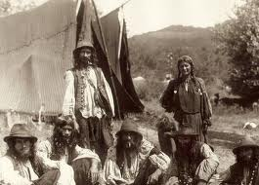
Nomads, tent gypsies

Slide 7
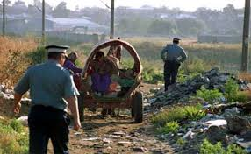
Travellers?

Slide 8
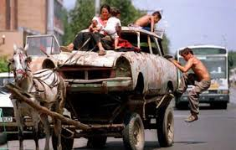
New travellers?

Slide 9
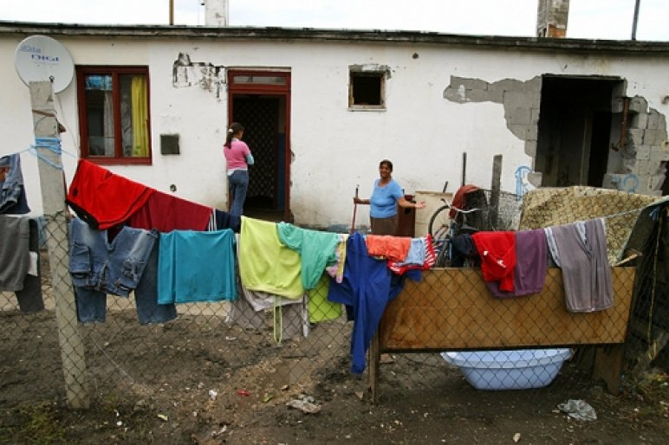
Uncivilized?

Slide 10
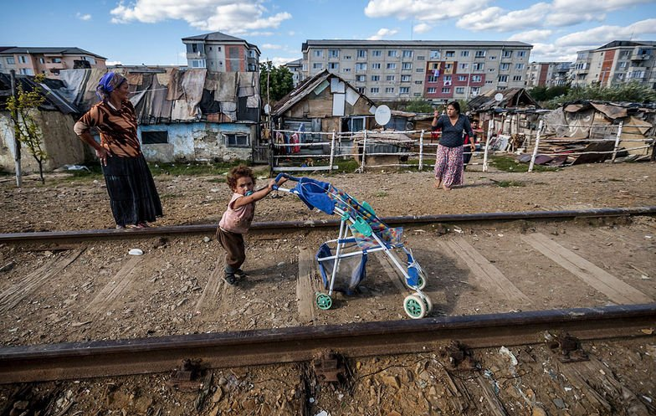
Unintegrated in the socitey?

Slide 11
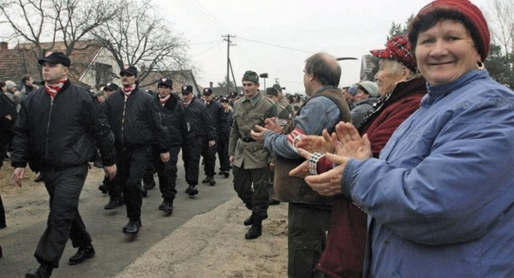
Target of xenophobic attitudes

Slide 12
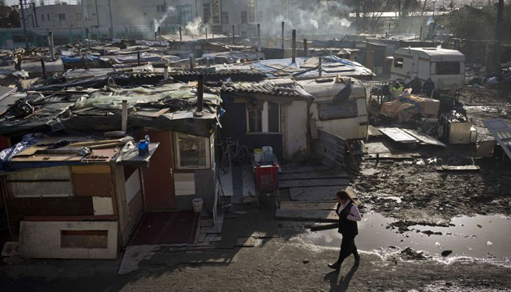
Migrants in Europe?

Slide 13
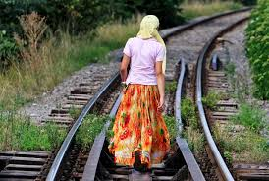

Slide 14
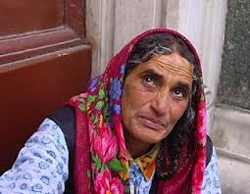

Slide 15
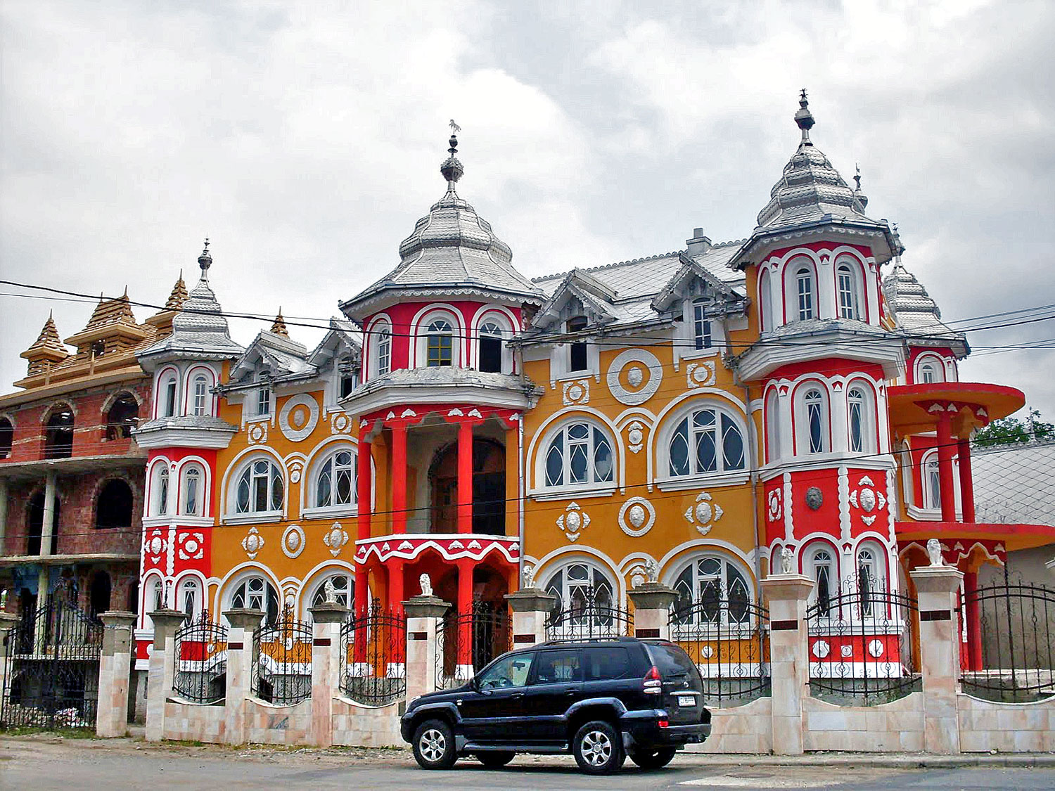
Living in poverty?

Slide 16
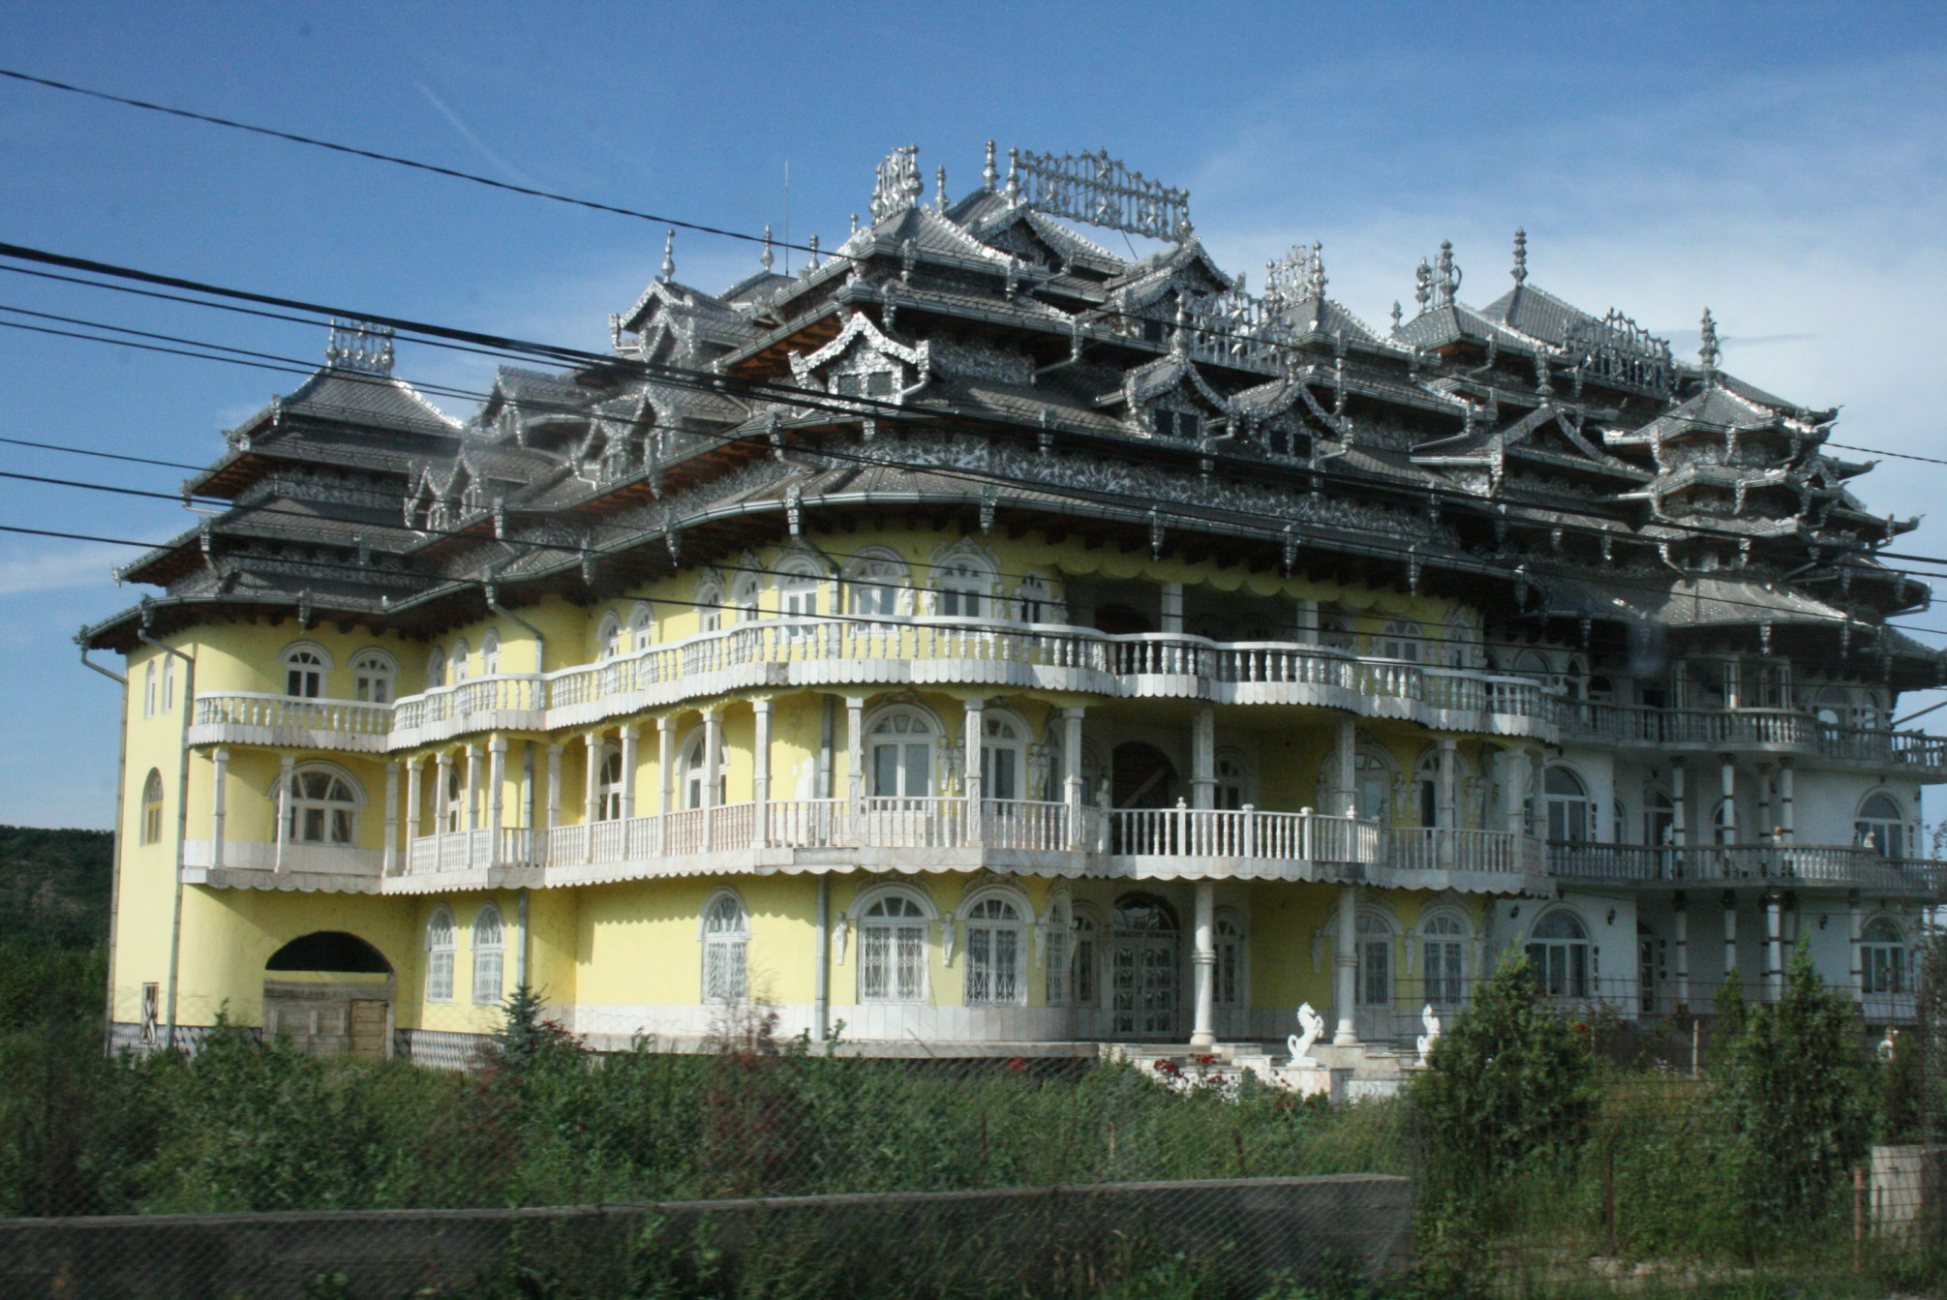

Slide 17
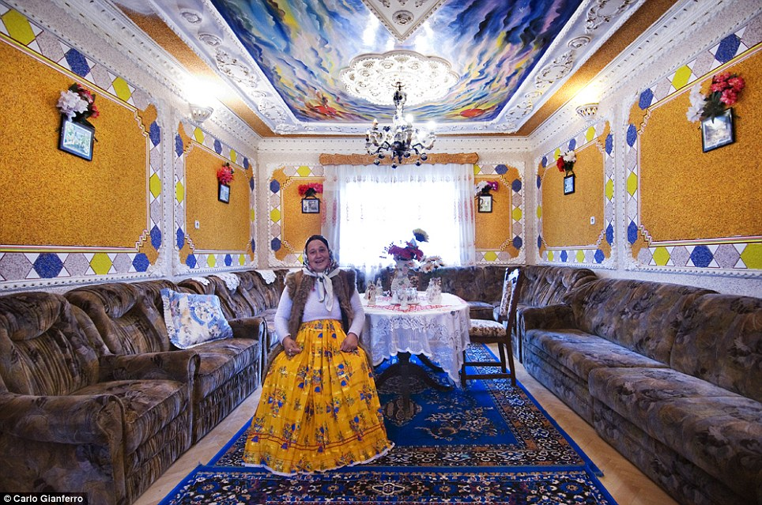

Slide 18
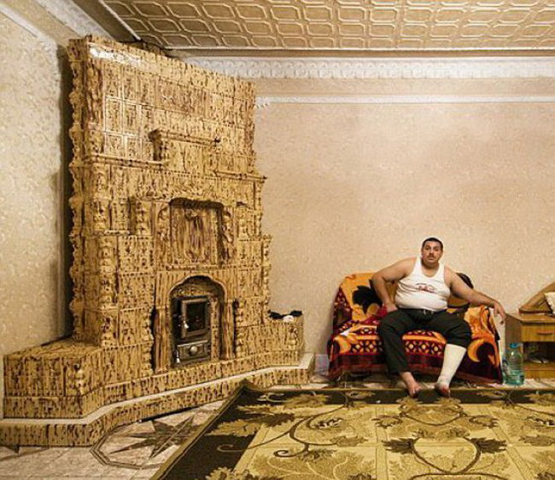

Slide 19
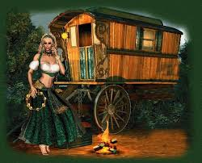
Liberty, target of „white gaze”

Slide 20
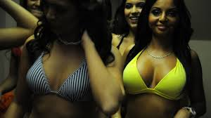
Roma body: the hidden desire

Slide 21


Fortune-teller

Slide 22
Dancer, Musicians
Цыганочка
https://www.youtube.com/watch?v=nx9vBw5dOZI
https://www.youtube.com/watch?v=PYyQbjgvv3s

Slide 23
Taraf De Haidouks - Balkan Gypsy Folk Music
https://www.youtube.com/watch?v=pT4IufMeyYA
Spain:
https://www.youtube.com/watch?v=4YUa_Qns0Ts

Slide 24
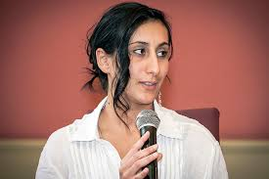
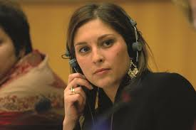
They are „Us”

Slide 25
Terminology
Roma, Romani
  Traditionally itinerant, wanderer ethnicity of Northern Indian origin
Gypsies, Gipsies
Kale, Kalo (kalo=black)
Ashkali, Sinti (German speaking EU)
Tsigani (Central and Eatern Europe)
Gitane (France), Gitanos (Spain), Zingari – Gitani (Italy)
Bohemiens, Manouches
Travellers

Slide 26
Roma – as a term
In Romani language
Rom – man, husband (masculin, noun)
Roma – plural form
Romani – feminin adjective
Romano – masculin adjective

Slide 27
Origins, short history of Romani people

Slide 28
Origins
Oxford English Dictionary: gipsy is a ”member of wandering race (by themselves called Romany), of Indian origin, which first appeared in England about the beginning of the 16th c.”
In Central and Eastern Europe appeared in 15th century

Slide 29
Migration
There is no written histroy
Linguistic and genetic evidence about migration routes
They may have emerged from India (Rajastahn, Punjab region) 250 BC
Westward migration in waves since 500 AD
They reached the Balkans as early as 12th century
First historical record in 1332, in Crete
By 1416 written evidence of Gypsies in Brasov (Kronstadt, Transylvania, Romania)
By 1440s they were recorded in Germany
By the 16th century in Scotland, Sweden
Some Romani migrated from Persia through North Africa, reaching the Iberian Peninsula in the 15th century
The two currents met in France

Slide 30
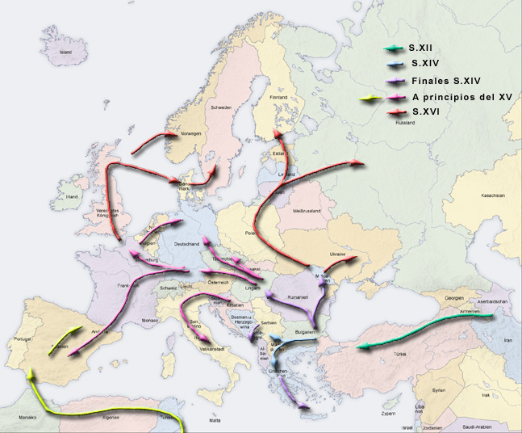
The migration of the Romanies

Slide 31
Early modern history
1385 marks the first recorded transaction for a Romani slave in Wallachia (Romania)
Romani could be kept as slaves in Wallachia and Moldavia until abolition in 1856
Gypsies were ordered expelled from Germany, Italy, Catalonia, Spain, France, Sweden, England in 15-16 centuries
Late 16th c. England, France gave Romanies special privileges that other wanderers lacked
Elsewhere in Europe, they were subject to ethnic cleansing, abduction of their children, and forced labor
As a result, large groups of the Romani moved to the East, toward Poland, which was more tolerant, and Russia

Slide 32
Modern history
Romani began emigrating to North America in colonial times, larger-scale Roma emigration to the United States began in the 1860s, with groups of Romanichal from Great Britain.
The largest number immigrated in the early 1900s, mainly from the Vlax group of Kalderash. Many Romani also settled in South America.
In Central Europe: attempts to settle down the nomads

Slide 33
World War II
The Romani genocide or Romani Holocaust, also known as the Porajmos was the effort during World War II. by the government of Nazi Germany and its allies to exterminate the Romani people of Europe.
Under Adolf Hitler’s rule, both Roma and Jews were defined by the Nuremberg laws as "enemies of the race-based state." These two groups (and others) were targeted by similar policies and persecution, culminating in the near annihilation of both populations within Nazi-occupied countries.
Estimates of the death of Romani in World War II range from 220,000 to 1,500,000.
In 1982, West Germany formally recognized that genocide had been committed against the Romani.
In 2011 the Polish Government passed a resolution for the official recognition of the 2nd of August as a day of commemoration of the genocide

Slide 34
After WWII
In socialist countries: trying to integrate in labour market
In Central European countries Roma question reformulated as a social question
  Education
  Eliminaton of slums
  Providing communitarian infrastructure
Majority of roma are settled
In Czechoslovakia Roma were labeled a "socially degraded stratum," and Romani women were sterilized as part of a state policy to reduce their population.

Slide 35
After collapse of communist regimes
Suddenly had changed their social situation
High rate of unemployment, low skills
Poverty
Poverty-induced crime has become frequent among the Roma in desperate situation
Majority: turn on the Roma with new hatred
Segregation in employment, discrimination in some social spheres
After mid 90’s: had become commonplace the idea of forced resettlement, attacks and atrocities committed against Roma by organized groups

Slide 36
Data, facts about Roma and the „Roma question”

Slide 37
Roma (Gypsy) categorization
Self-determination, self-identification
  Roma is who consider himself or herself as being Roma/Gypsy
External categorization
  Roma is who is considered as being Roma by others
  From external point of view on what basis could someone decide about ethnic affiliation? (racial marks, „gypsy-life”, local experts opinion)
estimation of nr. of Roma people is much higher than demographic (census) data

Slide 38
Questions on ethnic data
The role of the social, political context
Ethnic data: a tool for demonstrating (or rejecting) the multiethnic feature of society
The role of methodology
  How the questions are formulated?
  How explicit categories are used?
  The example-effect
  How many answers could be given to the ethnic (nationality) questions
    Is it accepted the double ethnic identity or not?

Slide 39
Operationalization of ethnic identity
How ethnicity is identified?
  By mother tongue (if so, which interpretation of mother tongue is used during the census)
  By language used in everyday situation
  By affiliation to certain groups
  By racial marks
  By affiliation to certain ethnic culture
  By affiliation to certain religious group

Slide 40
Ethnic identity
Any kind of identity is flexible and contextual
Process of dissimulation during ethnic identification – the role of social atmosphere
    If the atmospher is rather a xenophobic one, the roma population tends to choose the majority identity (In Slovakia, 90’s) – fear from differencesness
    If other national minority has a possible high prestige, the Roma population tends to declare themselves as being part of this national minority group (in Ukraine majority of Roma declare themselves as Hungarians)

Slide 41
Roma population
 | Roma – official data |  | Roma – estimated data
 | No. | % | No. (min. - max.) | Mean | %
Romania | 619 007 | 3,25 | 1 200 000– 2 500 000 | 1 850 000 | 9,72
Bulgaria | 370 908 | 5,11 | 700 000– 800 000 | 750 000 | 10,33
Hungary | 190 046 | 1,91 | 400 000 – 1 000 000 | 700 000 | 7,05
Serbia | 108 193 | 1,48 | 400 000– 800 000 | 600 000 | 8,19
Slovakia | 105 738 | 1,96 | 400 000 – 600 000 | 500 000 | 9,28
Poland | 12 731 |  | 15 000 – 60 000 | 37 500 | 0,10

Slide 42
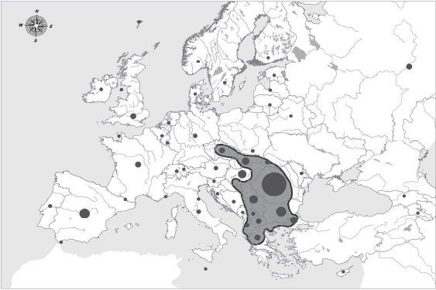
Distribution of Roma Population in Europe

Slide 43
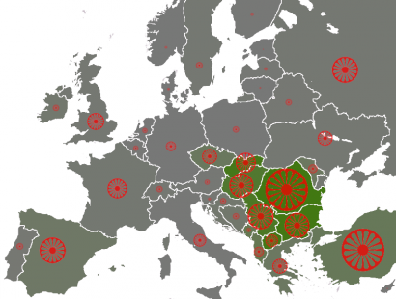

Slide 44
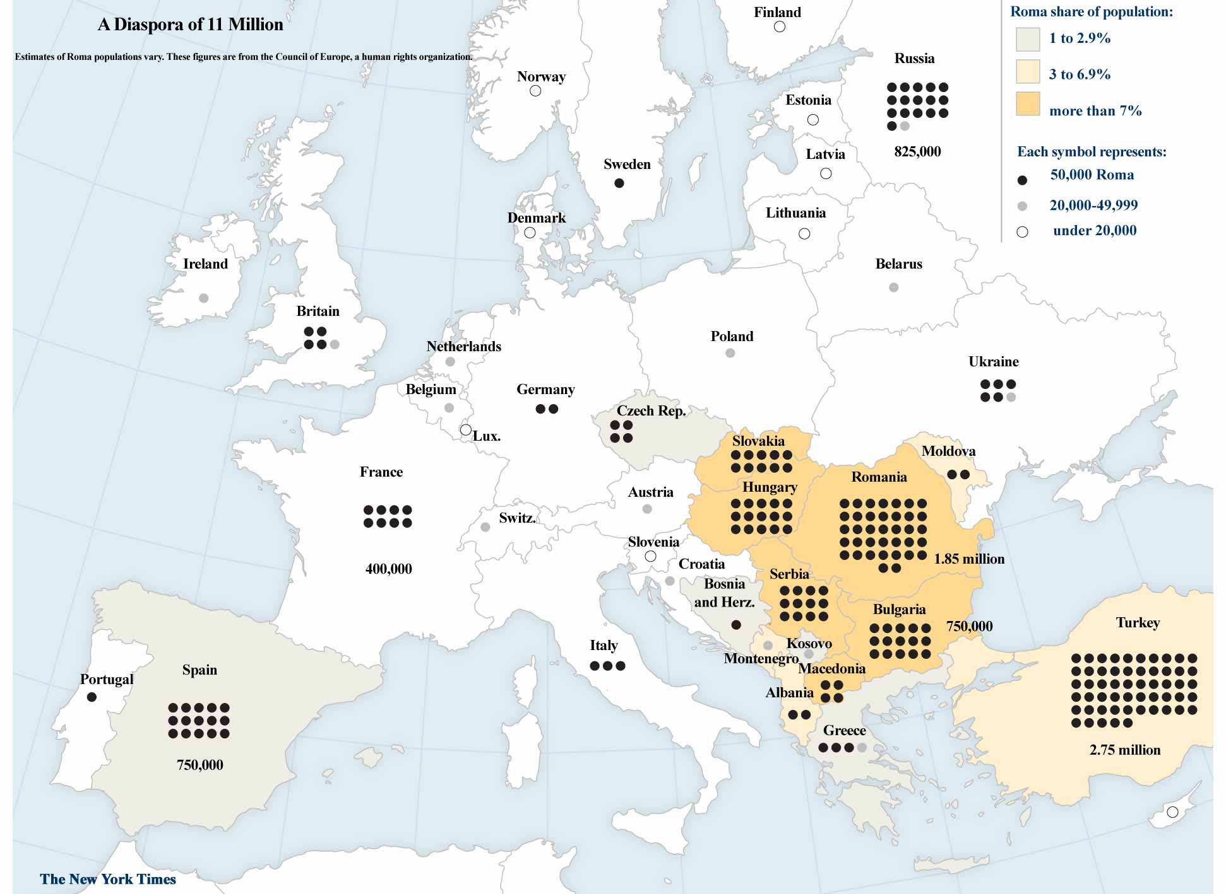

Slide 45
Approaches of Roma question
Historical point of view
From social situation perspective
From cultural point of view
From social-psychological point of view

Slide 46
Historical point of view
  History of misery, escaping, persecution
  Historical persecution
  Forced assimilation
  Holocaust – Porajmos
  Forced repatriation
  History of non-adaptation and non-integration

Slide 47
Social situation perspective
Roma question is a byproduct of certain social deviance : gypsy population has a special way of life, therefore they are responsible for their disadvanteged social situation
Emancipation-based approach: Roma are excluded from the society, they are discriminated, therefore they should be eliberated and empowered
Ethnograhpical and sociological descriptions
- essentialism: Roma have special ethnocultural features
- structural: social situation of Roma can be explained by interaction of Roma and non-Roma, and by taking into consideration the characteristics of the whole society
- Civilizatorical approach: majority of the society has the responsability to integrate Roma p.
- Critical discourses: it is the right of Roma (Roma elite) to decide about their life

Slide 48
Cultural point of view
Is there a specific roma ethnic culture today?
  What is culture?
Is there a culture of segregation, of social exclusion?
  Risk of blaming the victim

Slide 49
Underclass formation
Culture of poverty
Structural constrains
(dezindustrialization, system of prejudices etc.)

Slide 50
Elements of culture of poverty (ghetto)
Ulf Hannertz
  Women domination in the household
  Conflictual gender relationships
  Suspicion to others, outsiders
  Inclination to religiousity (and superstition)
Edward Banfield (1959)
  Amoral familism
  Lack of solidarity (civil society)
Oscar Lewis (1966)
  Feeling of inferiority, of personal unworthiness
  Present-orientation: people have very little sense of history
  Hedonism with special sexual behaviour

Slide 51
Elements of culture of poverty among Roma (in Hungary)
Iván Szelényi – János Ladányi (based on a fieldtrip in a Hu. village more than 10 years)
  Irational belief on social equality
  Lack of solidarity
  Lack of authority
  Strait (narrow) time perception

Slide 52
Representation of Roma in Art and Fiction
In opera, literature and music
  Romani women have been portrayed as provocative, sexually available, gaudy, exotic, mysterious
In popular culture:
  Similarities to Jewish people
  Negative stereotypes: they are wandering, spreading disease, abducting children, violating others
Romanticized narrative of Roma
  mystical powers of fortune telling
  Love of freedom
  Habit of criminality

Slide 53
ROMA IN HUNGARY

Slide 54
Roma in Hungary
Not a homogenous ethnic (linguistic, cultural) group
  Lovari (Vlach), Beash and Rom-Ungro group
  High degree of linguistic assimilation
There is no exact data about Roma
„Who is Roma?/Gipsy?”
There is no official ethnic data on education since 1991 (but we have estimation using NABC)
  Self-identification (350.000 Census 2011)
  External categorization (cca. 600-800.000)
Contradiction: striving for „resolving” the Roma issue without confident data

Slide 55
Roma population as linguistic groups
According to Kamill Erdős (1958)
Those whose mother tongue is the Gypsy lg.
  Those who speak the so-colled Carpathian Gypsy lg.
  Those who speak the so-called Romany or Vlach Gypsy lg.
Those whose mother tongue is not the Gypsy lg.
  Those whose mother tongue is Hungarian (Romungro)
    They are descendants of the Carpathian and Vlach gypsies
      „musicians”
      adobe makers, basket weavers, day labourers (poor group)
  Those whose mother tongue is Romanian (Boyash)
    Romanian Gypsies
    The tub-makers Gypsies

Slide 56
Roma population as linguistic groups (István Kemény, 1971)
Hungarian Roma belong to three main linguistic group
Hungarian Gypsies or Romungro – who speak Hungarian and who call themselves „musician Gypsies”
Bilingual (Hungarian and Gypsy) Vlach Gypsies – Roma, Rom
Hungarian – Romanian bilingual Gypsies, who call themselves „Boyash”
  The Mucsán (live in South Baranya County)
  The Argyelán – speak the banat dialect
  Ticsán – came from the region of nagyvárad (Oradea) in the 1910’s, reaching the region Tiszafüred after living in Szabolcs and Szatmár counties

Slide 57
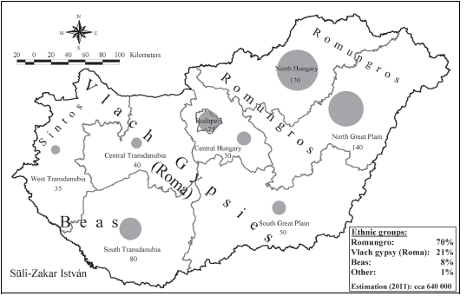
Roma/Gypsy Groups in Hungary

Slide 58
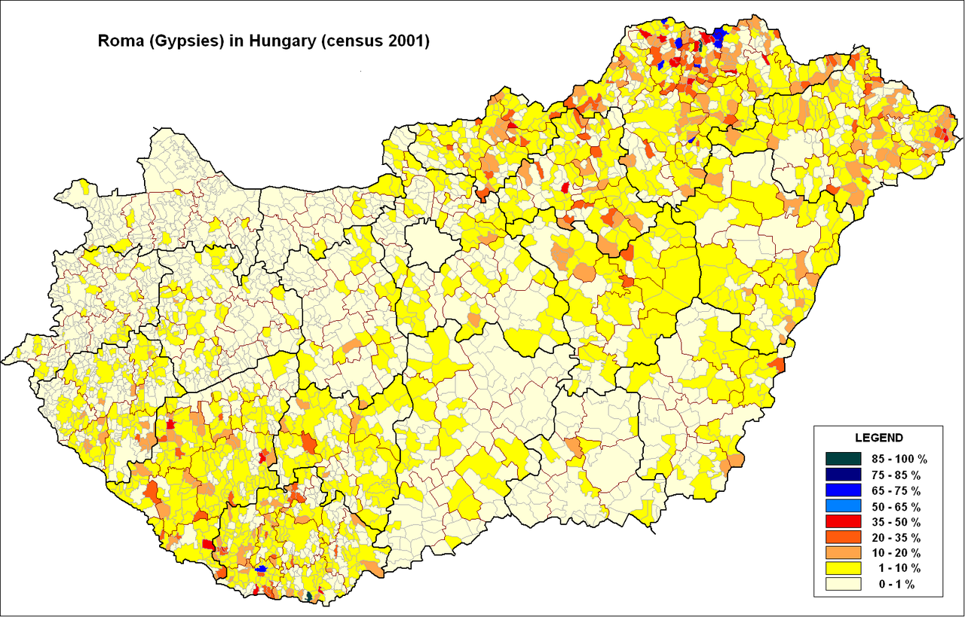

Slide 59
Distribution of Gypsies according to mother tongues
 | Hungarian | Boyash | Gypsy | Other | Total
1971 | 71 | 7,6 | 21,2 | 0,2 | 100
1993 | 89,5 | 5,5 | 4,4 | 0,6 | 100

Slide 60
Explanation of linguistic assimilation
Among the Boyash and the Vlah Gypsies one can find a kind of bilingualism
  one language is used as an instrument of intimate, familar communication
  the other belongs to the „formal”, official spheres – education, public offices, workplace
Eliminiation of the majority of gypsy slums between 1965 and 1985 definitely contributed to the change of languages
- 1971: 75% Vlah Gypsies, and 48% of the Boyash lived in slums
- 1993: 4,9 Vlah Gypsies, 1,1 Boaysah
Integration on workplace during state socialism : 1971 – 84% of Boyash and 75% of Vlach men were employed in places where they were forced to speak Hungarian, they had to use Hungarian to communicate in formal situations

Slide 61
Ethnographical and Cultural Antropological aspects
  Ethnograhpic and folklore research have been prinarly interested in Vlach Gypsies who were regarded as traditional community
  Socio-antropological approach: examines the culture of Roma groups as a living culture whose primary function is
    to organize the communitiy and life
    to maintain the survival of the social group and
    to ensure livelihood
Michael Stewart (Brothers of Song)
in describing Vlach Gypsies he examined both their relationship with the peasents and other Gypsy groups
draws the distinction between
  Vlach Gypsies whose lifstyle and philosophy is traditional and different from that of society and its codified set of values and
  The Hungarian Gypsies who try to conform to the value system of society in their lifestyles and outlook

Slide 62
Why is important the Roma education issue in HU? – question of integration
Demographic and regional aspects (territorial segregation)
Disadvantaged social situation and „Roma question” are interrelated
Low school participation rate among Roma pupils at higher school levels
High social costs (low skills – high unemployment)
The question of equity

Slide 63
The rate of Roma students in Hungarian school system (1969-2009) – ISCED 2

Slide 64
Estimated rate of Roma children by county (2008/09)
 |  | 30%+
 |  | 25,1-30%
 |  | 20,1-25%
 |  | 15,1-20%
 |  | 10,1-15%
 |  | 5,1-10%
 |  | 0-5%

Slide 65
Equity in education (OECD)
Fairness
  making sure that personal and social circumstances (for example gender, socio-economic status or ethnic origin) should not be an obstacle to achieving educational potential
Inclusion
  ensuring a basic minimum standard of education for all – for example that everyone should be able to read, write and do simple arithmetic.
  The two dimensions are closely intertwined: tackling school failure helps to overcome the effects of social deprivation which often causes school failure.

Slide 66
Education of Roma pupils in Hungarian school system
Significant differences in school achievement between socially disadvantaged and non-disadvantaged students
Chances of a Roma child for high school graduation are 50 times less than that of a non-Roma.
Selectivity of the school system: The differences in school achievements among schools are more significant than the differences between the achievements of students within the schools.
In the OECD countries the 41% of differences in reading achievement could be explained by the differences among schools, while this proportion is 67% in Hungary. (PISA, 2009)

Slide 67
Variance in student performance between schools (PISA 2009)

Slide 68
Measuring integration – national perspective
Wholistic competency test (school achievement measured by standardized tests)
Contains data: estimated rate of Roma students at school level
International (PISA) methodology can be applied
Qualitative research perspective:
  The role of integration at local levels
  Local embedness of school processes

Slide 69
Matematics performances by the rate of Roma students (8. grade, 2009) | Reading performances by the rate of Roma students (8. grade, 2009)

Slide 70
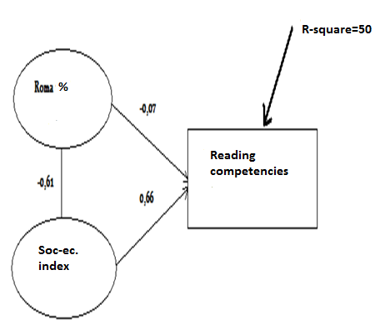
Influencing factors of reading competencies

Slide 71
Types of Segregation
Territorial segregation
Segregation between schools
Segregation within schools:
    Special classes
    Remedial classes
    Elite classes
Special schools
„Study-at-home” schools (private students)

Slide 72
Segregated schools: homogeneous school composition
residential segregation
demographic processes (voluntary vs. non-voluntary segregation)
more advantaged students leaving the schools
discriminatory practices: creation of Roma-only schools, channelling of disadvantaged children into special schools

Slide 73
European perspective

Slide 74
EU Framework for National Roma Integration Strategies up to 2020
European Commission, 2011
Many of the estimated 10-12 million Roma in Europe face prejudice, intolerance, discrimination and social exclusion in their daily lives
This EU Framework seeks to make a tangible difference to Roma people's lives. It is the EU's response to the current situation and does not replace Member States' primary responsibility in this regard.
With this EU Framework, the European Commission encourages Member States, in proportion to the size of the Roma population living in their territories and taking into account their different starting points, to adopt or to develop further a comprehensive approach to Roma integration and endorse the following goals.

Slide 75
EU NRSI
A need for a targeted approach: an EU framework for national roma integration strategies
Expressing the EU ambition: setting Roma integration goals
  Access to education: Ensure that all Roma children complete at least primary school
  Access to employment: Cut the employment gap between Roma and the rest of the population
  Access to healthcare: Reduce the gap in health status between the Roma and the rest of the population
  Access to housing and essential services: Close the gap between the share of Roma with access to housing and to public utilities (such as water, electricity and gas) and that of the rest of the population

Slide 76
EU NRSI
National roma integration strategies: a clear policy commitment from member states
Achieving concrete results for Roma people
Promoting roma integration beyond the EU: the particular situation of enlargement countries
Empowering civil society: a stronger role for the european platform for roma inclusion
Measuring progress: putting in place a robust monitoring system

Slide 77
Conclusions, final messages
  Roma: enigma of recent history
  Social integration could have many meanings: to be good citizen or human being, full member of society, community
  There are 2 models of integration: secular model and religious model (L. Fosztó)
  EU and national level integration strategies tries to adopt secular model (fighting discrimation, improving social condition, providing empowerment)
  Religious, conversion model:
    Conversion narrative and born again personhood
    The transformed community
    Rituals are mainly focused inwards to the internal transformation of individuals and the community
    Social consequences
  https://www.youtube.com/watch?v=7F16OUl-uno

Slide 78
▐ Attila Papp Z.▐ MTA TK KI▐ 15 July 2015▐
Thank you for your attention!
pappz.attila@tk.mta.hu
kisebbsegkutato@tk.mta.hu

