Slide 1
Refugees
Migrants
Stateless
Dr Katarzyna Przybysławska, Halina Nieć Legal Aid Center

Slide 2
The Halina Nieć Legal Aid Center, (HNLAC) is a non-profit non-governmental organisation
established in 2002 in Kraków, Poland.
HNLAC’s main objective is to protect human rights by providing free legal aid to persons at risk of social exclusion and discrimination, including the poor, victims of domestic violence, human trafficking, foreigners, asylum seekers, refugees and the stateless.

Slide 3
Who are refugees?

Slide 4
1951 GENEVA CONVENTION
Adopted on 28 July 1951
Originally restricted due to geographical and temporal limit: „(…) in Europe before 1 January 1951 (…)”
Changes due to the 1967 New York Protocol relating to the Status of Refugees
Regulates the legal status of refugees, lays down minimum standards of treatment and provides for their documentation

Slide 5
WHO IS A REFUGEE?
Art. 1 A of a 1951 Geneva Convention –
A person who „owing to well-founded fear of being persecuted for reasons of race, religion, nationality, membership of a particular social group or political opinion, is outside the country of his nationality and is unable or, owing to such fear, is unwilling to avail himself of the protection of that country (…)”

Slide 6
MAIN ELEMENTS OF REFUGEE DEFINITION
well – founded fear
of persecution
based on one of 5 grounds
lack of the protection of the country
person outside the country of the nationality

Slide 7
Article 6 Actors of persecution or serious harm
Actors of persecution or serious harm include:
(a) the State;
(b) parties or organisations controlling the State or a substantial
part of the territory of the State;
(c) non-State actors, if it can be demonstrated that the actors
mentioned in points (a) and (b), including international
organisations, are unable or unwilling to provide protection
against persecution or serious harm as defined in Article 7

Slide 8
ACTS OF PERSECUTION
1. In order to be regarded as an act of persecution within the
meaning of Article 1(A) of the Geneva Convention, an act must:
(a) be sufficiently serious by its nature or repetition as to constitute a severe violation of basic human rights, in particular the rights from which derogation cannot be made under Article 15(2) of the European Convention for the Protection of Human Rights and Fundamental Freedoms;
or
(b) be an accumulation of various measures, including violations of human rights which is sufficiently severe as to affect an individual in a similar manner as mentioned in point (a)

Slide 9
ACTS Of PERSECUTION
2. Acts of persecution as qualified in paragraph 1 can, inter alia, take the form of:
(a) acts of physical or mental violence, including acts of sexual violence;
(b) legal, administrative, police, and/or judicial measures which are in themselves discriminatory or which are implemented in a discriminatory manner;
(c) prosecution or punishment which is disproportionate or discriminatory;
(d) denial of judicial redress resulting in a disproportionate or discriminatory punishment;
(e) prosecution or punishment for refusal to perform military service in a conflict, where performing military service would include crimes or acts falling within the scope of the grounds for exclusion as set out in Article 12(2);
(f) acts of a gender-specific or child-specific nature.
3. In accordance with point (d) of Article 2, there must be a connection between the reasons mentioned in Article 10 and the acts of persecution as qualified in paragraph 1 of this Article or the absence of protection against such acts

Slide 10
Article 10 Reasons for persecution
1. Member States shall take the following elements into account when assessing the reasons for persecution:
(a) the concept of race shall, in particular, include considerations of colour, descent, or membership of a particular ethnic group;
(b) the concept of religion shall in particular include the holding of theistic, non-theistic and atheistic beliefs, the participation in, or abstention from, formal worship in private or in public, either alone or in community with others, other religious acts or expressions of view, or forms of personal or communal conduct based on or mandated by any religious belief

Slide 11
NATIONALITY
the concept of nationality shall not be confined to citizenship or lack thereof but shall, in particular, include membership of a group determined by its cultural, ethnic, or linguistic identity, common geographical or political origins or its relationship with the population of another State;
(d) a group shall be considered to form a particular social group where in particular:

Slide 12
SOCIAL GROUP
— members of that group share an innate characteristic, or a common background that cannot be changed, or share a characteristic or belief that is so fundamental to identity or conscience that a person should not be
forced to renounce it, and — that group has a distinct identity in the relevant country,
because it is perceived as being different by the
surrounding society

Slide 13
POLITICAL OPINION
(e) the concept of political opinion shall, in particular, include the holding of an opinion, thought or belief on a matter related to the potential actors of persecution mentioned in
Article 6 and to their policies or methods, whether or not that opinion, thought or belief has been acted upon by the applicant

Slide 14
PERCEPTION OF GROUND
when assessing if an applicant has a well-founded fear of being persecuted it is immaterial whether the applicant actually possesses the racial, religious, national, social or political characteristic which attracts the persecution, provided that such a characteristic is attributed to the applicant by the actor of persecution.

Slide 15
NON-REFOULEMENT
The basic and the primary rule of the 1951 Geneva Convention
Obliges the countries to provide access to territory and asylum
Art. 33 „ No contracting State shall expel or return („refouler”) a refugee in any manner whatsoever to the frontiers of the territories where his life or freedom would be threatened on account of his race, religion, nationality, membership of a particular social group or political opinion”

Slide 16
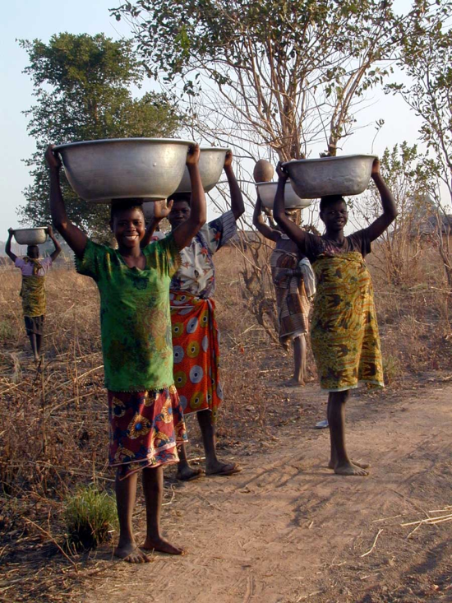
WHO IS A PERSON OF CONCERN?
Asylum seeker
Refugee
IDP
Returnee
Stateless person

Slide 17
Why do we help refugees?

Slide 18
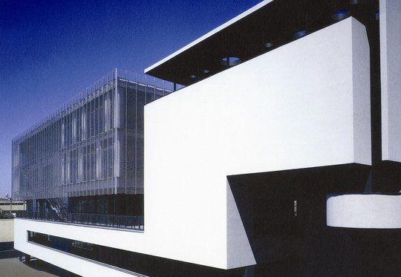
CEAS
Central European Asylum System
EASO in Malta
Four core directives:
Qualification
Procedural
Reception
Return

Slide 19
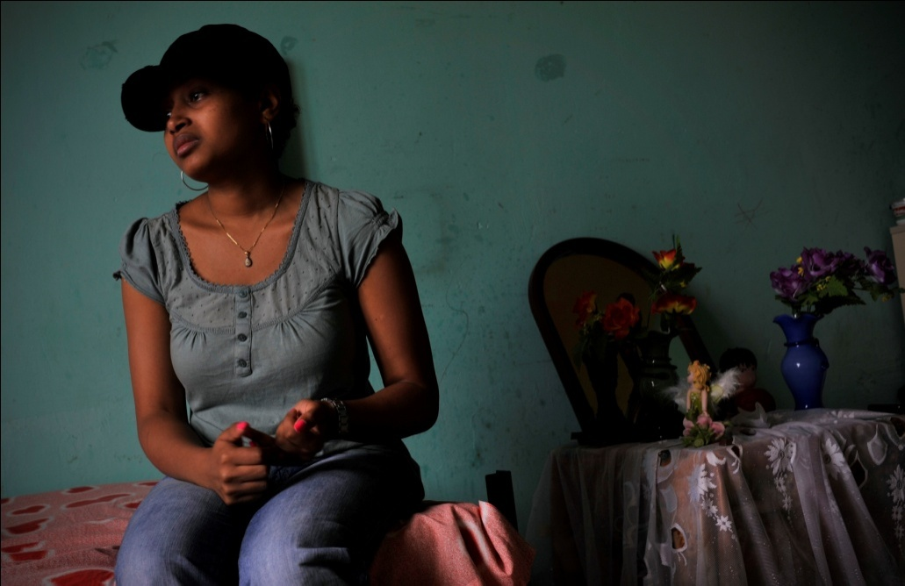
…+ one regulation- Dublin III
„Dublin system”
…the country of the first entry
EURODAC
Refers only to asylum seekers

Slide 20
Who helps refugees?

Slide 21
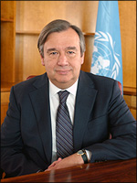
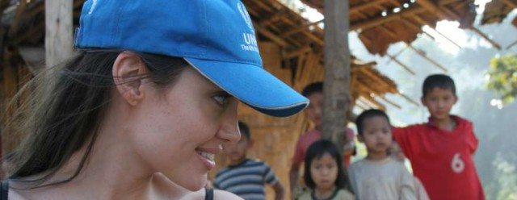

Slide 22
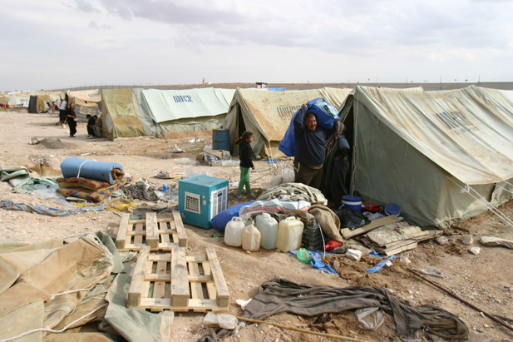

Slide 23
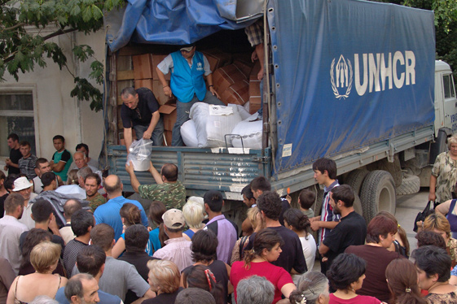
IN SEARCH OF DURABLE SOLUTIONS
Durable solution:
Voluntary repatriation
Integration
Resettlement

Slide 24
VOLUNTARY REPATRIATION
UNHCR works with the country of origin and host countries to help refugees return home
Safety and dignity
Ensure the exercise of a free and informed choice
The largest repatriation operation – Afghanistan- 4,5 mln persons since 2002

Slide 25
INTEGRATION
Complex and gradual process which comprises distinct but related legal, economic, social and cultural dimensions
During the past decade, 1.1 million refugees around the world became citizens in their country of asylum
More than 6,5 mln of persons stay in refuge more than 5 years

Slide 26
RESETTLEMENT
Some refugees cannot go home or are unwilling to do so because they will face continued persecution. Many are living in perilous situations or have specific needs that cannot be addressed in the first country
Out of 10 mln refugees of concern to UNHCR only around 1 % is being resettled
Main countries of resettlement – Thailand, Nepal, Syria, Jordan
EU concept of relocation

Slide 28
CHALLENGES

Slide 29
How many refugees and displaced people
are there?

Slide 30
EUROPE IN A WORLD OF DISPLACEMENT
59.5 million people worldwide were forcibly displaced at the end of 2014, as a result of persecution, conflict and human rights violations, the highest level on record.
That was 8.3 million people more than at the end of 2013: the biggest annual increase ever in a single year. 19.5 million of those people were refugees.

Slide 31
What are the main host countries?

Slide 32
EUROPE IN A WORLD OF DISPLACEMENT
EU countries hosted a relatively small share of that number. At the end of 2014, the world’s top refugee host was Turkey, followed by Pakistan, Lebanon, Iran, Ethiopia and Jordan.
Lebanon hosted by far the largest number of refugees by population, 232 per 1,000 inhabitants. Worldwide, 86 per cent of the refugees under UNHCR’s mandate lived in developing countries.

Slide 33
SYRIA CRISIS
An estimated 9 million Syrians have fled their homes since the outbreak of civil war in March 2011, taking refuge in neighbouring countries or within Syria itself.
Over 3 million have fled to Syria's immediate neighbours Turkey, Lebanon, Jordan and Iraq.
6.5 million are internally displaced within Syria. Meanwhile, under 150,000 Syrians have declared asylum in the European Union
Overall, there are now 4,013,000 Syrian refugees; the largest single refugee group for nearly 25 years.

Slide 34
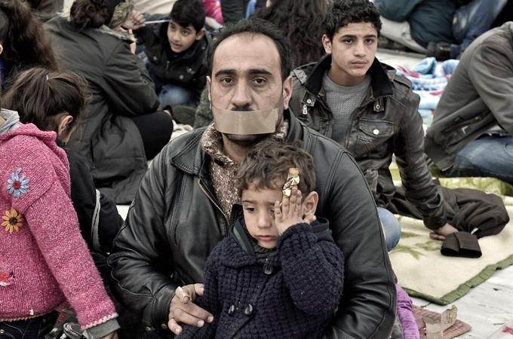

Slide 35
World’s largest refugee camp is…

Slide 36
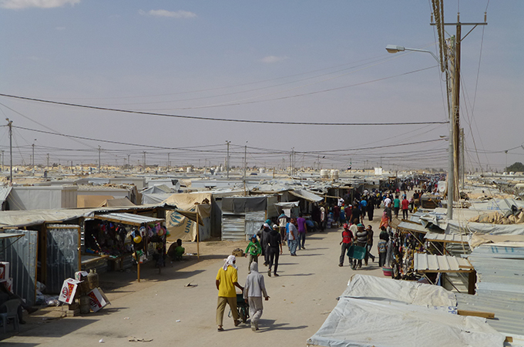

Slide 37
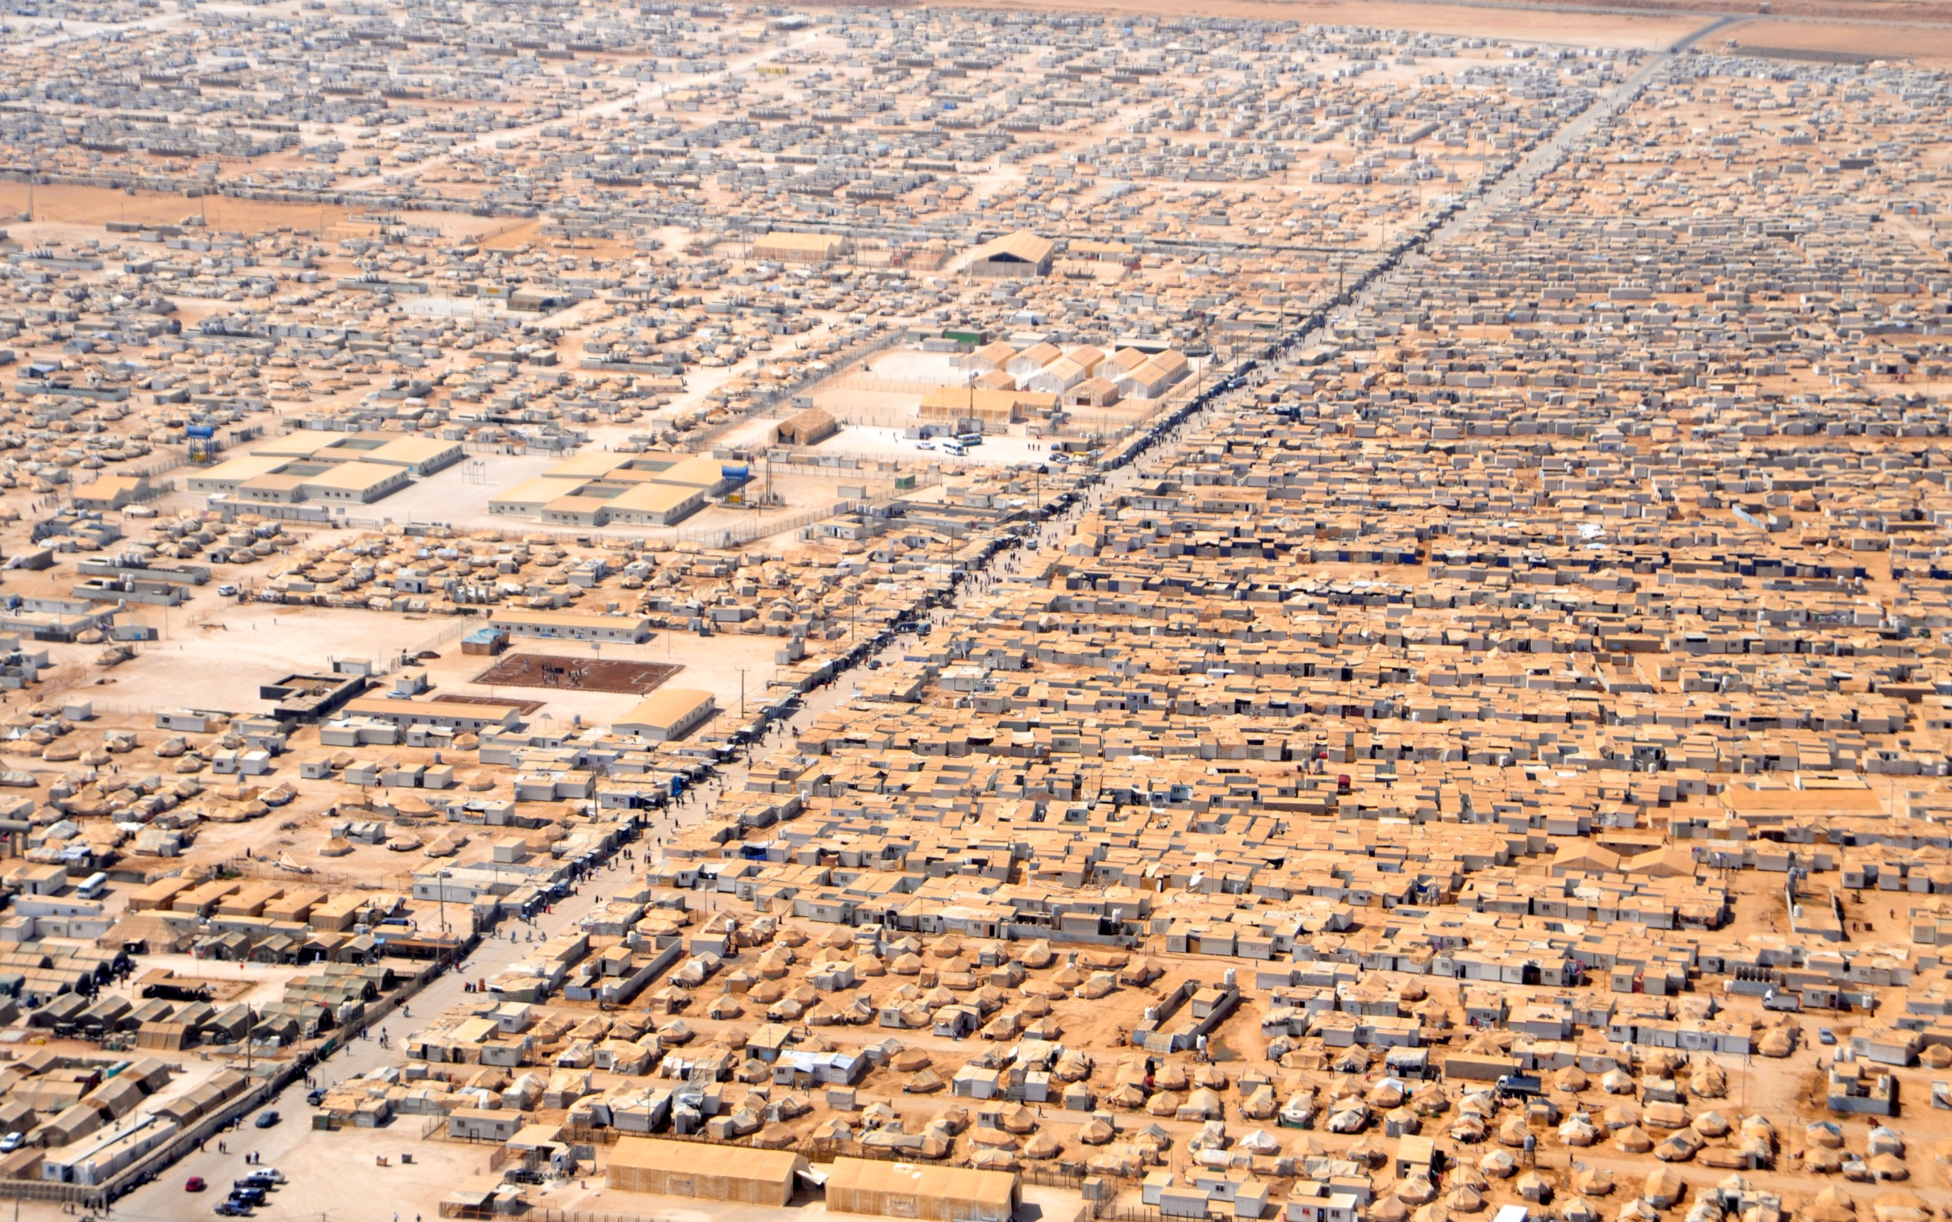

Slide 44
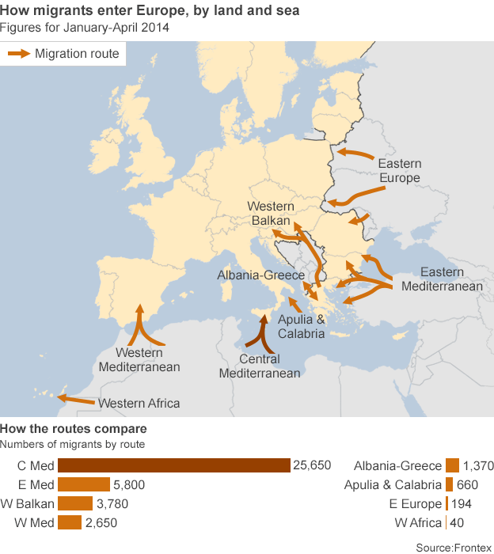

Slide 45
Mediterranean Refugee crisis
Europe is living through a maritime refugee crisis of historic proportions.
Its evolving response has become one of the continent’s defining challenges of the early 21st century, with long-lasting implications for humanitarian practice, regional stability and international public opinion.

Slide 46
Mediterranean Refugee crisis
In the first six months of this year, 137,000 refugees and migrants crossed the Mediterranean Sea, travelling in terrible conditions upon unsafe boats and dinghies.

Slide 47
Mediterranean Refugee crisis
Many more tried, but didn’t make it.
In mid-April 2015, 800 people died in the largest refugee shipwreck on record, highlighting a staggering increase in refugees and migrants dying or missing at sea. This tragedy thrust the crisis into headlines around the world, and the EU launched a series of emergency meetings to establish a more effective joint response.

Slide 48
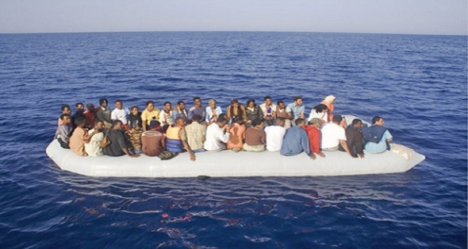

Slide 52
Life expectancy

Slide 53
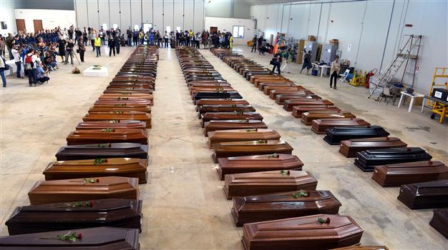

Slide 54
Mediterranean Refugee crisis
These events raise profound questions. Who are the people arriving on Europe’s southern shores, where are they coming from, and why?
How can Europe best help them, both to alleviate the suffering that drives them further from their homes, and to address its root causes?

Slide 55
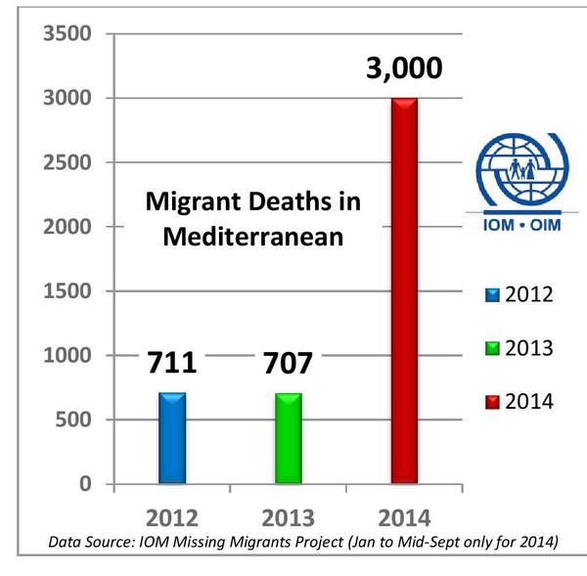

Slide 56
European Court of Human Rights
Hirsi Jamaa and Others v. Italy (2012) is the first case in which the European Court of Human Rights delivers a judgment on interception-at-sea.
Violations of Article 3 ECHR prohibiting inhuman and degrading treatment on a double count (risk of ill-treatment in Libya and risk of repatriation from Libya to countries where ill-treatment is rife),
a violation of Article 4 of Protocol no. 4 prohibiting collective expulsion and
a violation of Article 13 ECHR guaranteeing a domestic remedy for any arguable complaint of a violation of the Convention.

Slide 57
A NEW HOPE?
The number of deaths at sea rose to record levels in April 2015, then dropped significantly in May and June. While many factors contributed to the recent decline, improved European-led search-and-rescue operations beginning in May have had an immediate and positive impact. Yet the peak months still lie ahead.

Slide 58
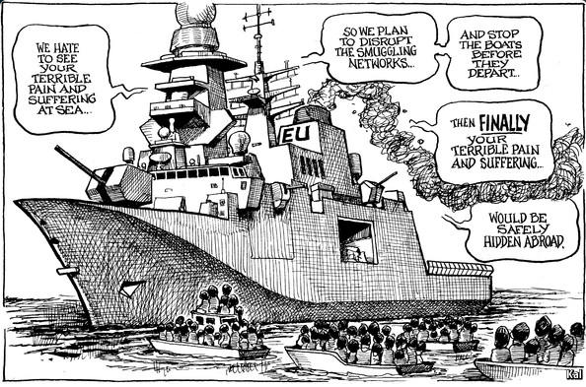

Slide 59
EU AGENDA…

Slide 60
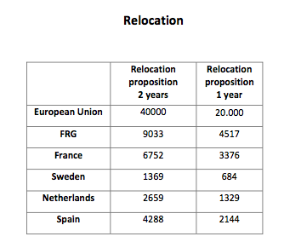

Slide 61
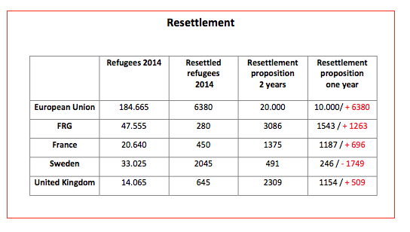

Slide 62
Building walls…

Slide 63
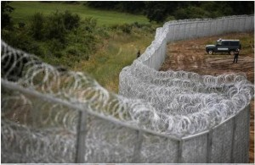

Slide 64
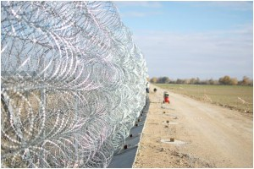

Slide 65
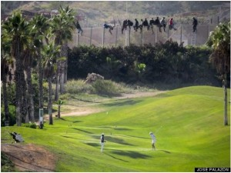

Slide 66
New walls are planned. Recently Hungary annouced a similar wall/fence to be built along the border with Serbia

Slide 69
More about Halina Niec Legal Aid Center…

Slide 70
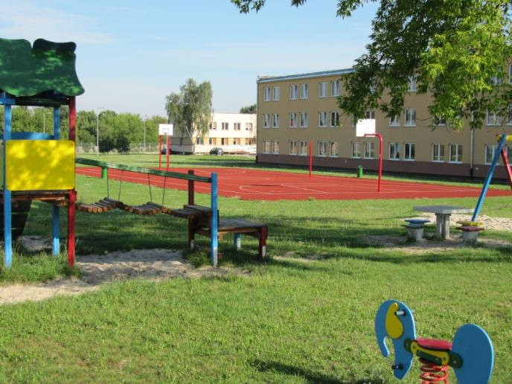
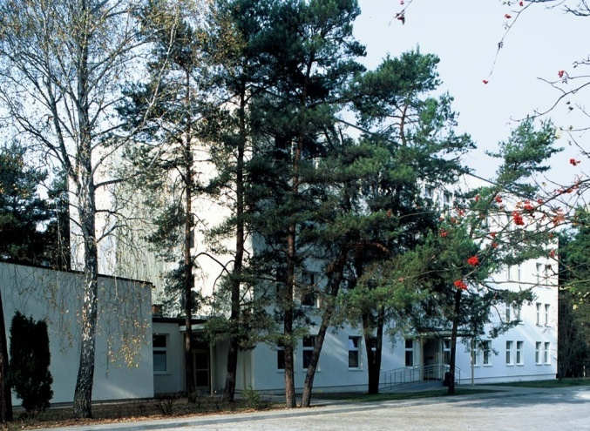
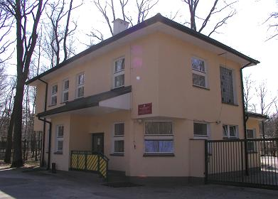
CENTRES FOR ASYLUM SEEKERS
The Office for Foreigners runs 13 centres for asylum seekers, 4 of them are under the ownership of the Office and 8 are rented from private owners. The total accommodation capacity is approx. 2200 places.

Slide 71
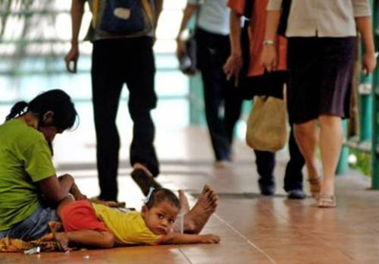
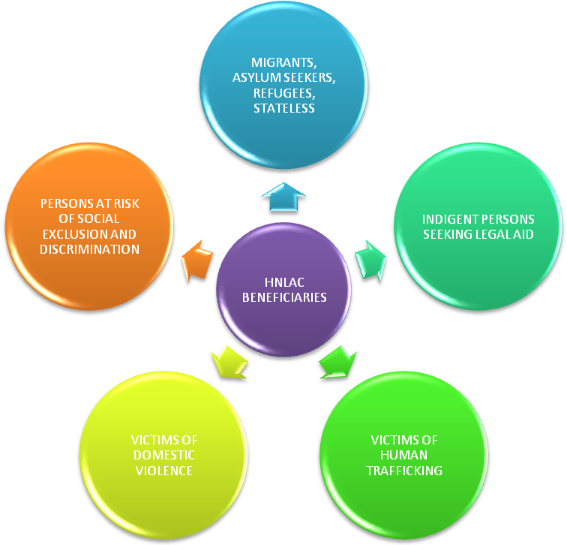
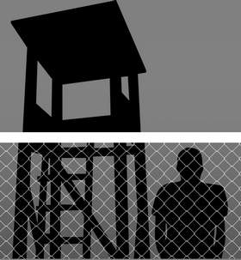
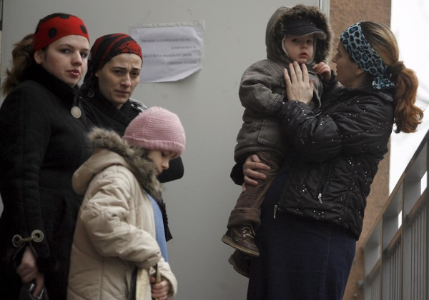
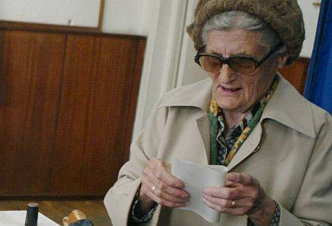

Slide 72
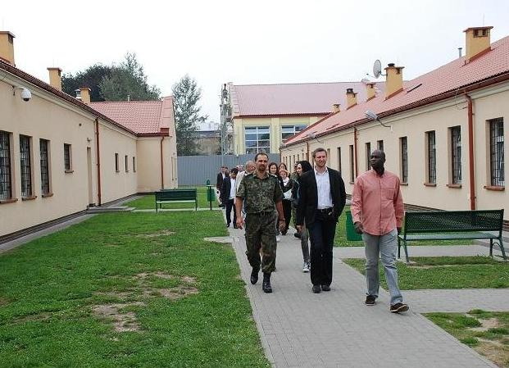
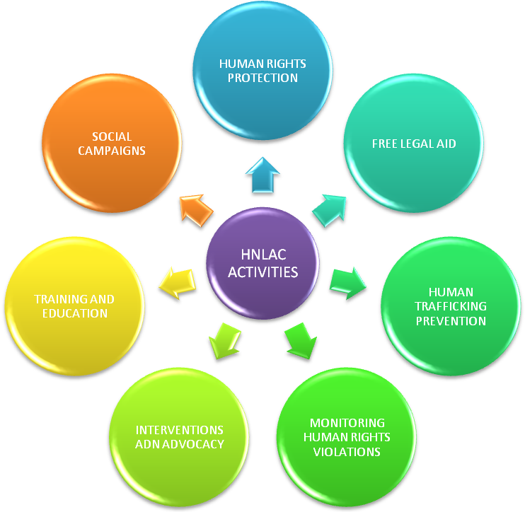
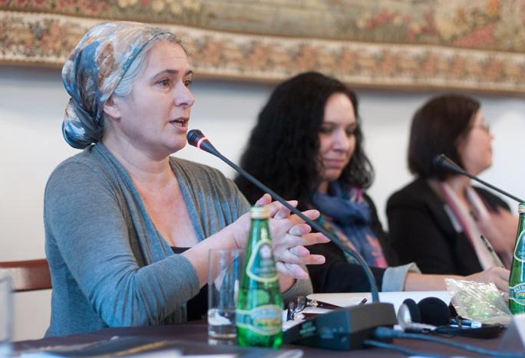
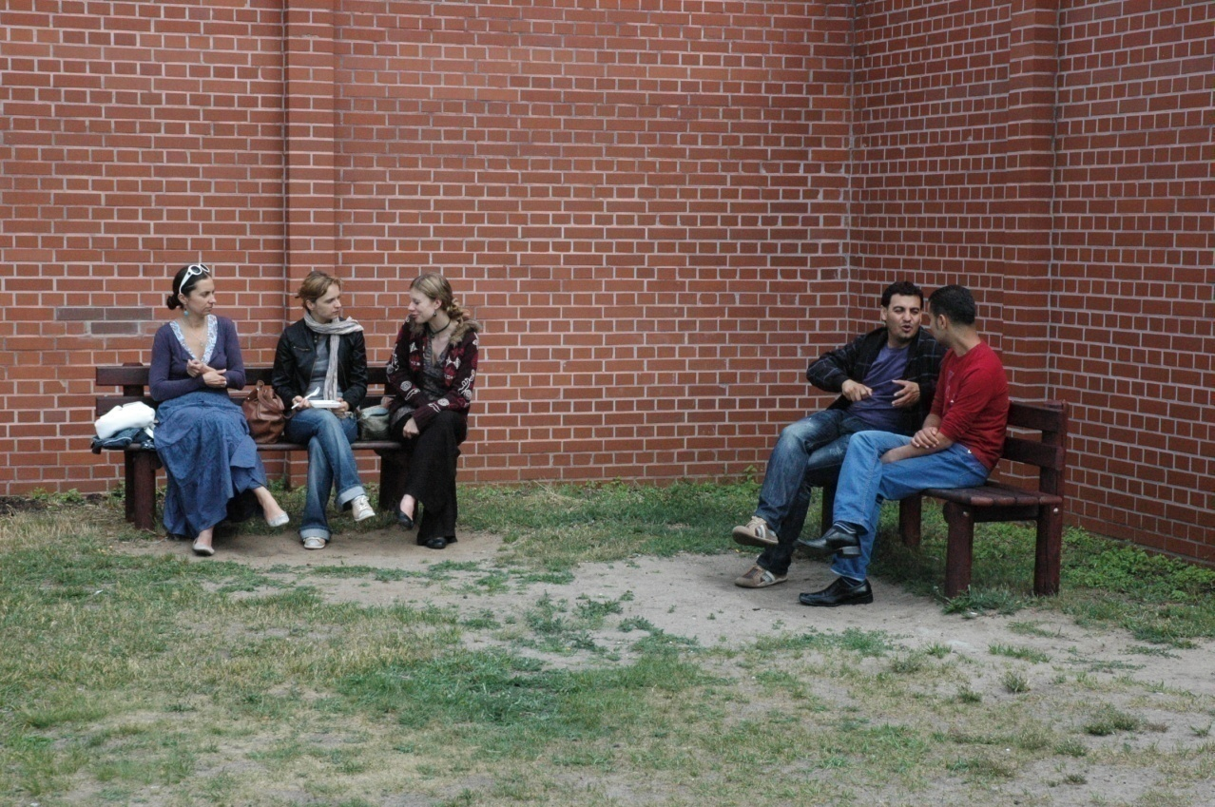
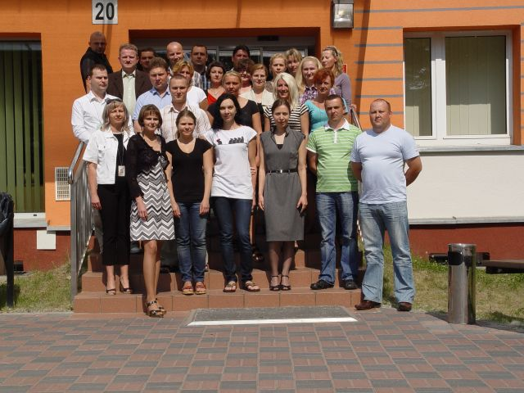

Slide 73
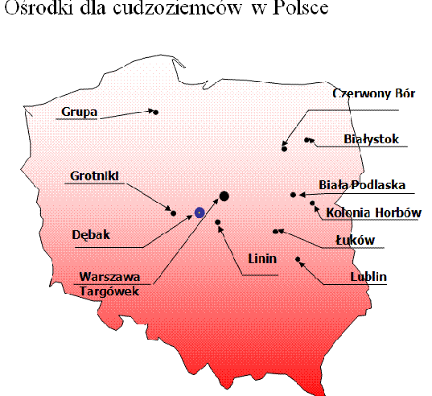
Refugee centers - open

Slide 74
Detention facilities – guarded centers
Strzeżony Ośrodek w Kętrzynie
Strzeżony Ośrodek w Białymstoku
Strzeżony Ośrodek w
Krośnie Odrzańskim
Strzeżony Ośrodek w Lesznowoli
Strzeżony Ośrodek w Białej Podlaskiej
Strzeżony Ośrodek w Przemyślu
Centrum Pomocy Prawnej regularnie odwiedza strzeżone ośrodki w Przemyślu, Białej Podlaskiej, Lesznowoli, Kętrzynie oraz Krośnie Odrzańskim.

Slide 75
2013 Statistics – asylum seekers
In 2013 Poland admitted a record number of over 15 000 asylum applications.
85% were citizens of Russian Federation. 8% are Georgian, 2% Syrian, Armenians: 1%, Kazakchs: 1%

Slide 76
2013 Statistics – asylum seekers
Refugee status was granted mostly to:
Syrians (35%) stateless from Syria (13%), Russian citizens (12%), Afghanis (12%) Belarussians (12%)
Suplementary protection was afforded to: Russian citizens (65%), Syrians (15%), Kazakchs and Somalis (5% each), Ukrainians (4%)
Tolerated status: Russian citizens (70%), Georgians (16%), Armenians (6%), Ukrainians (2%), Kirgiz (1%)

Slide 77
2014 Statistics – asylum seekers
According to the information provided by the Office for Foreigners, in 2014:
8199 applicants filed for the refugee status in Poland (6623 were new applicants and 1575 were persons who reopened their refugee procedures).
Out of that number the majority of applications were submitted by citizens of Russian Federation, Georgia and Ukraine. In 2014 267 decisions granted refugee status to applicants (262 in first instance and 5 in second), 181 supplementary protection (170 in first instance and 11 in second), and 302 permit for tolerated stay (195 in first instance and 7 in second).
5 557 proceedings were discontinued.

Slide 78
https://www.youtube.com/watch?v=_OUpsWCvE38
https://www.youtube.com/watch?v=nz8r42S8Eo8

Slide 79
przybyslawska@pomocprawna.org
youtube.com/CentrumPomocyPrawnej
facebook.com/pomocprawna.org
pomocprawna.org
@kasia_zz
@CPPHN

