Slide 1
Political transformations
#VSS2015

Slide 2
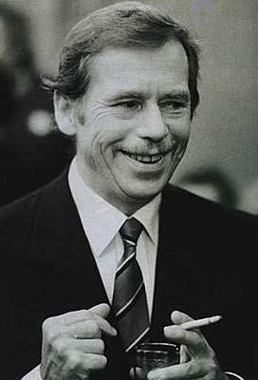
The start
Vaclav Havel, 1990:
“we have an opportunity to transform Central Europe from what has been a mainly historical and spiritual phenomenon into a political phenomenon … we can offer the inspiration to consider swift and daring solutions”.

Slide 3
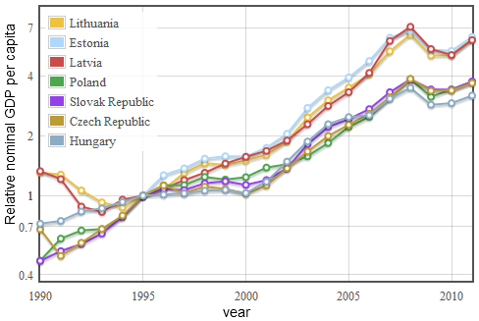
GDP growth V4+
The ratio of GDP in US dollars per capita in 1990-2011 to the GDP in reference year 1995 for Baltic and Visegrad states.

Slide 4
V4 Success
Back in the mid-1990s our collective GDP was some 260 billion USD. It is now four times larger, a trillion USD, bigger than Turkey`s.
If we were one country we would be well within the top twenty economic powers on the planet, as V4 we would move to 15 th rank in terms of purchasing power parity. Ahead of Indonesia, Turkey, Iran, Australia and Taiwan. Source

Slide 5
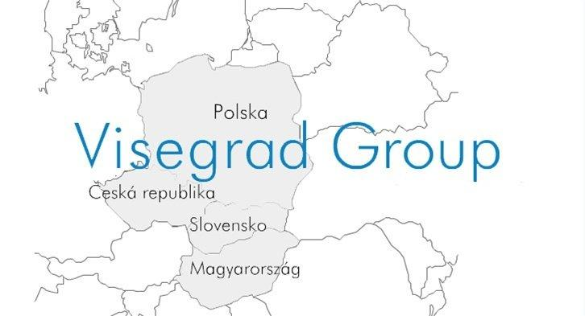
V4 as a model…?

Slide 6
Embedded liberalism
„the activities of transnational corporations, particularly with regard to core standards in labor and human rights; the organization of the international financial architecture; and the formal rules and informal norms of international organizations“
(Rawi Abdelal and John G. Ruggie, 2009)

Slide 7
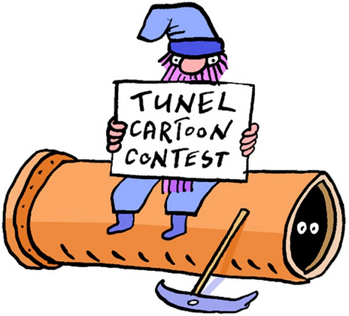
Economical transformation
Shock therapy
Gradualism
Privatization – voucher
Foreign direct investment
Pro-western orientated trade

Slide 8
Political transition
Leadership – dissidents + economists
Democracy
Pluralism - multi-party system
Foreign policy orientation to west
NATO

Slide 9
V4 in 1989… and EaP 26 years later

Slide 10
Economical factors
1989 V4 | Eastern Partnership in 2015
neo-liberal consensus | no common vision
higher output potential | lower output potential
less oligarchic | more oligarchic

Slide 11
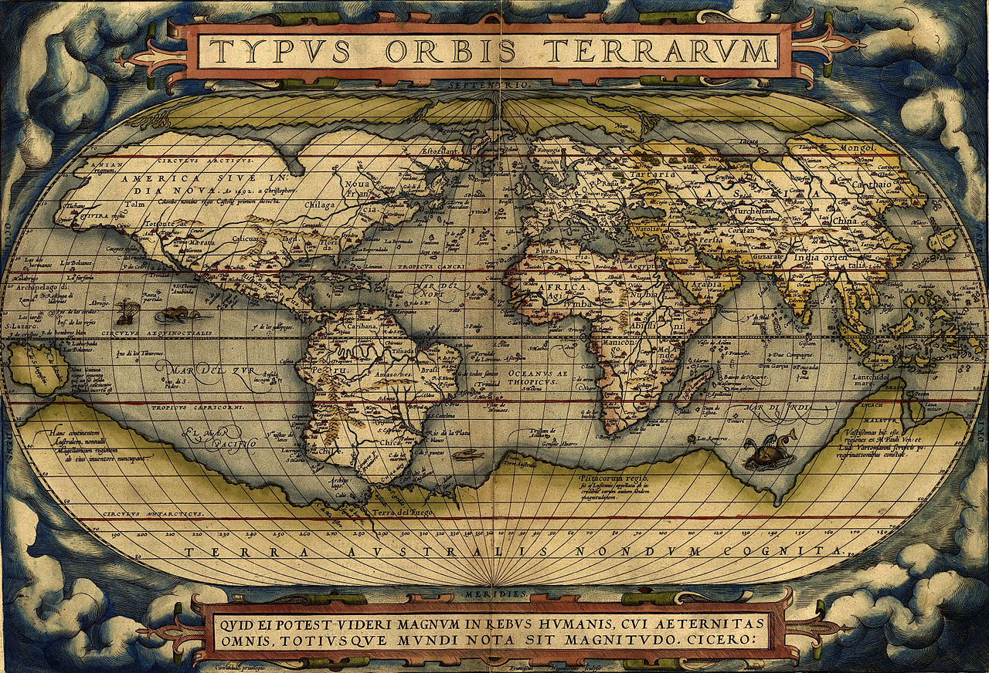
External factors
1989 V4 | Eastern Partnership in 2015
The end of Cold War | Return of geopolitical thinking
Fukuyama | Zakaria
“A Kidnapped West” returns to its place Kundera | Unclear perspective

Slide 12
Internal factors: history, society...
1989 V4 | Eastern Partnership in 2015
post-communist states | post-soviet states
relatively peaceful environment | frozen conflicts
tradition of modern statehood | post-soviet nostalgia

Slide 13
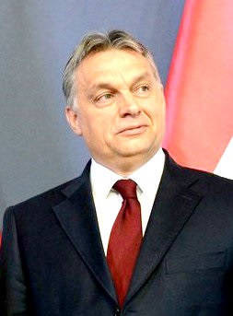
Second wave of transformation?
Financial crisis 2008
Case of Orbán's Hungary
State capitalism vs. market economy

Slide 14
How should the transformation continue?
Competitiveness and efficiency
Research and development - innovations
EU funds - “Junker's package”
Energy Union - cheap energy

Slide 15
More suggestions
Education and infrastructure
Effective state apparatus and transparency
Flexible market and fair opportunities for migrants
Environmental policy and green energy
Fair welfare system

Slide 16
Thank you for attention

