Slide 1
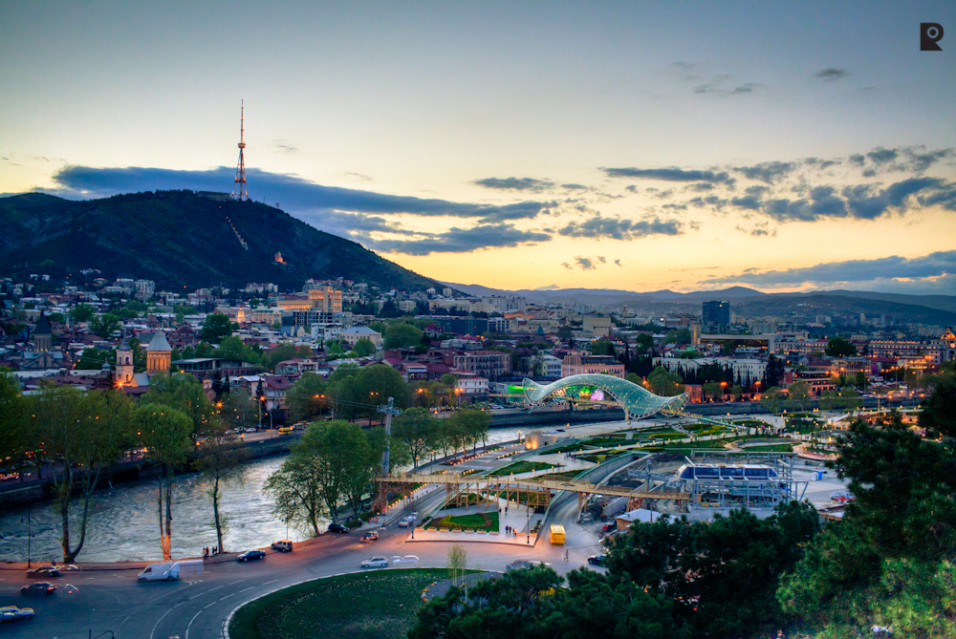
DISCOVER GEORGIA

Slide 2
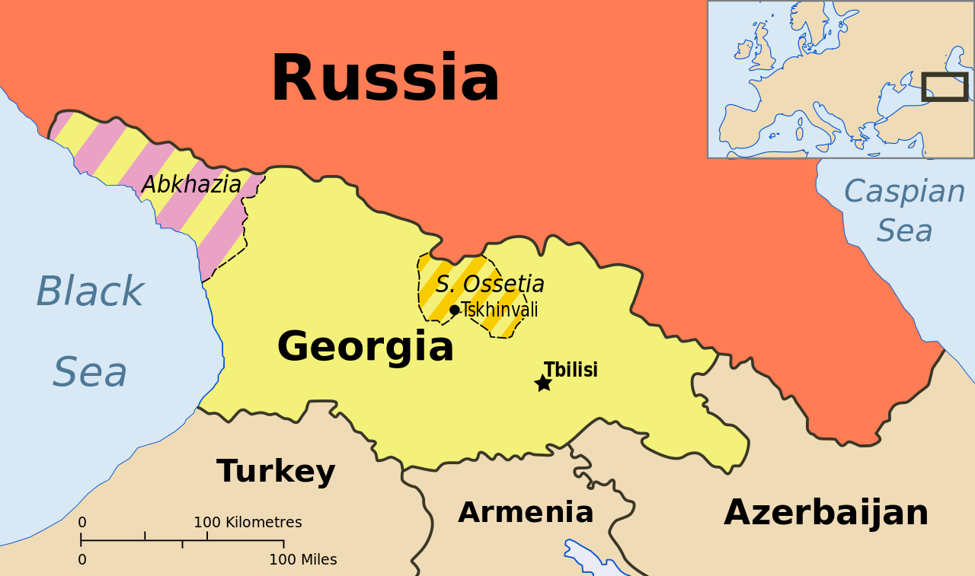

Slide 3
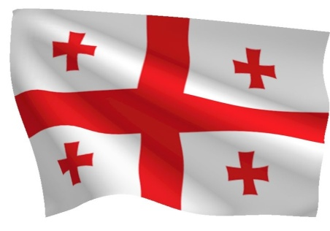
Brief Information
Capital – Tbilisi
Official language – Georgian
Government – Parliamentary republic
Population – about 4 mln
Religion – Orthodox Christianity
Currency – Georgian Lari

Slide 4
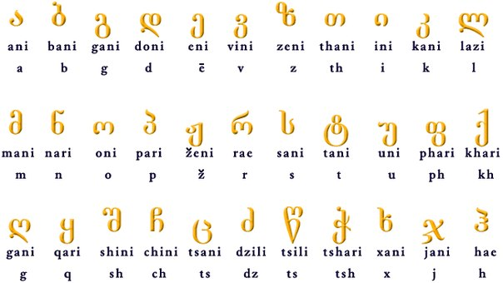

Slide 5
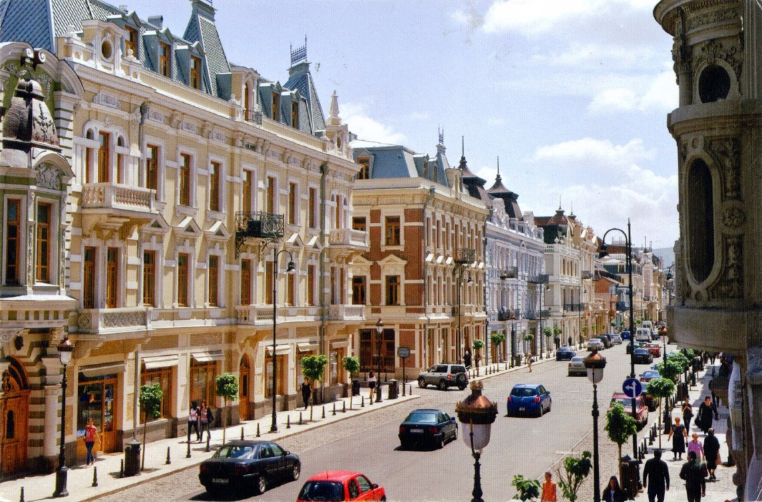
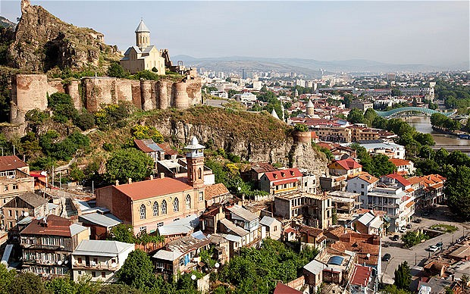
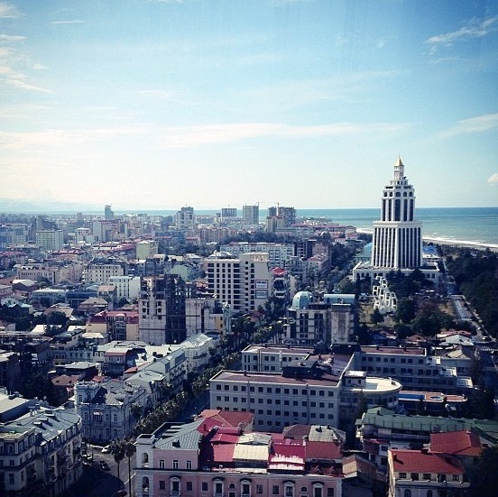
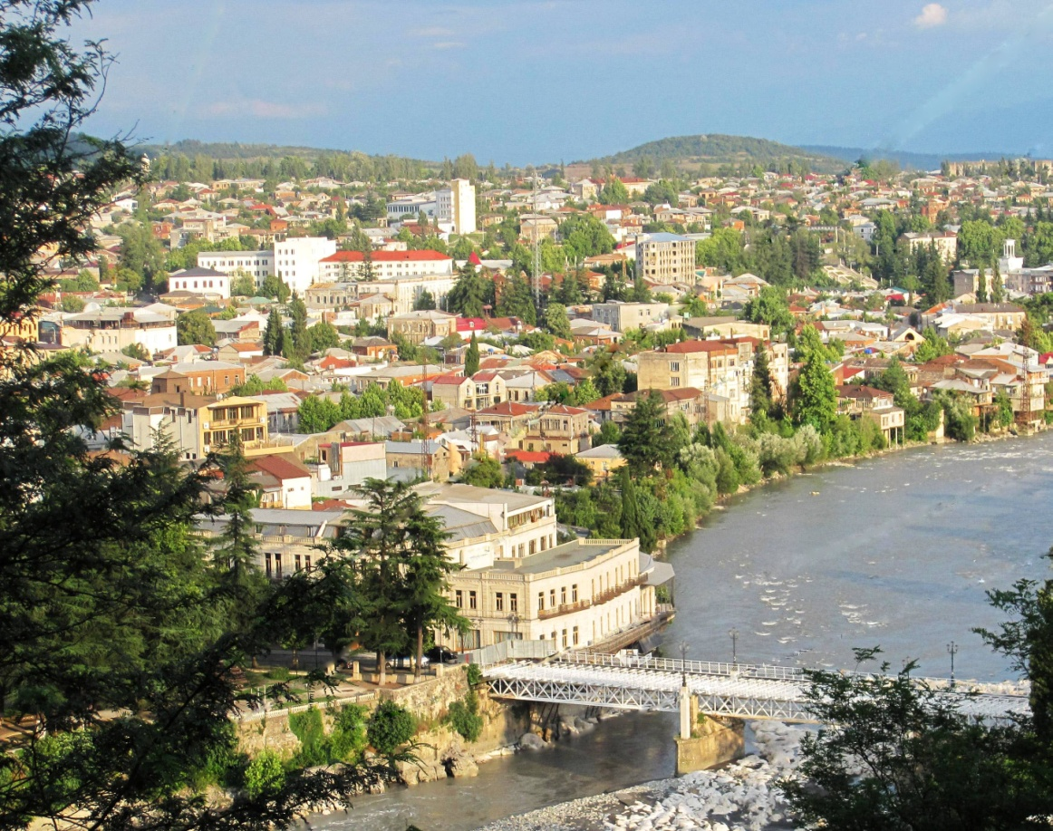
Biggest Cities

Slide 6
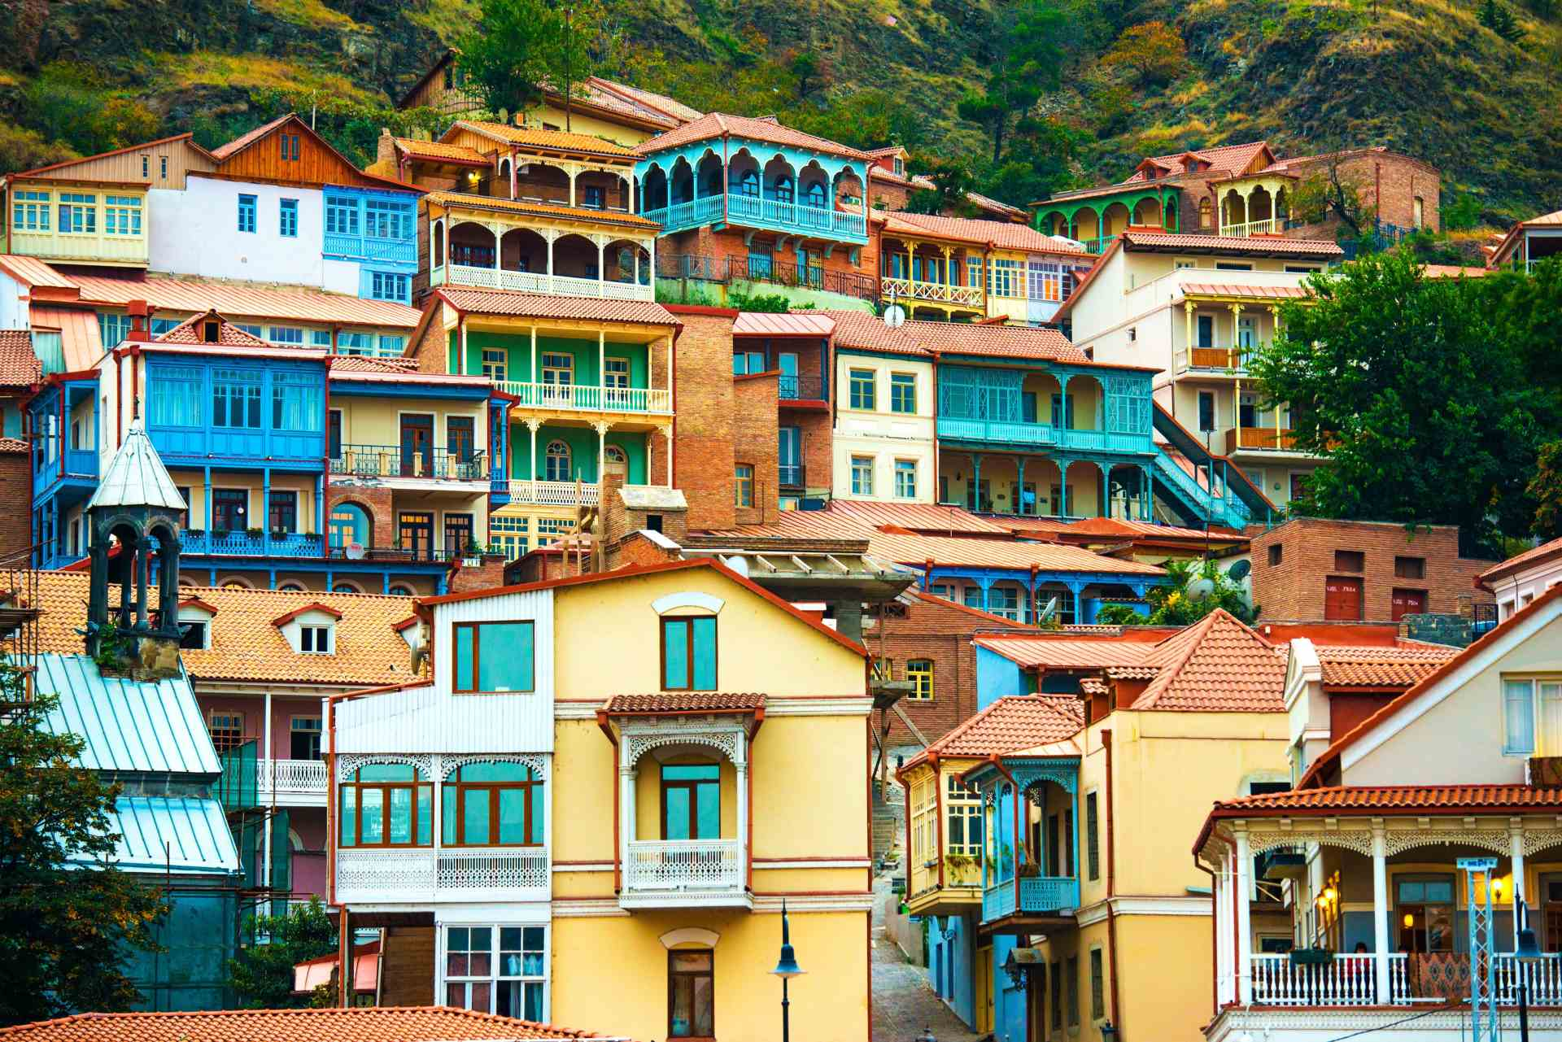
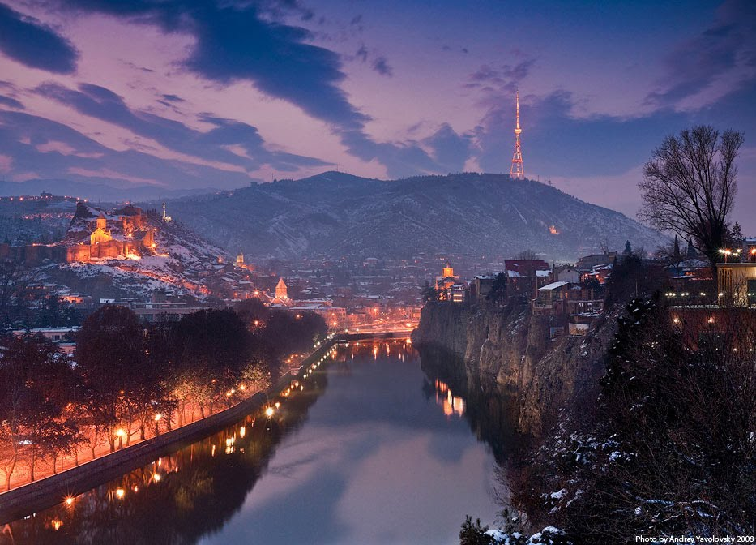
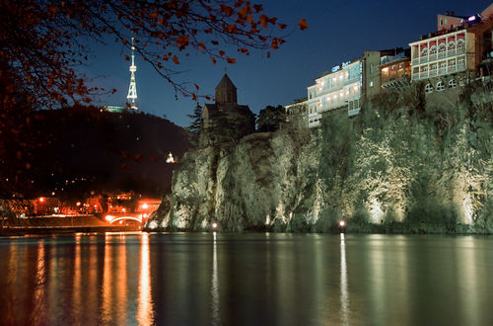
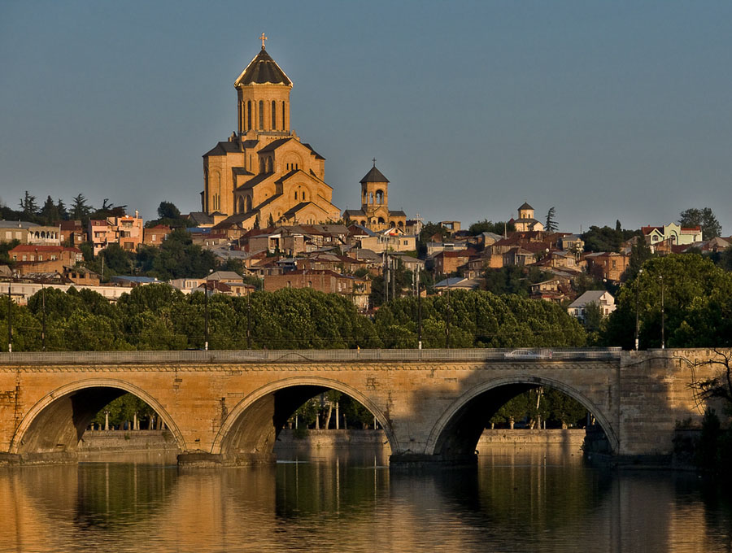
TBILISI

Slide 7
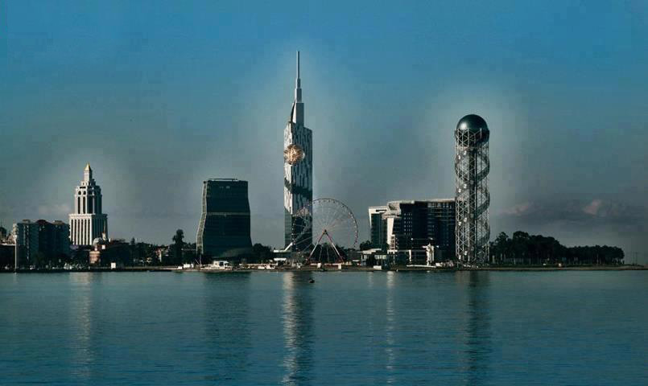
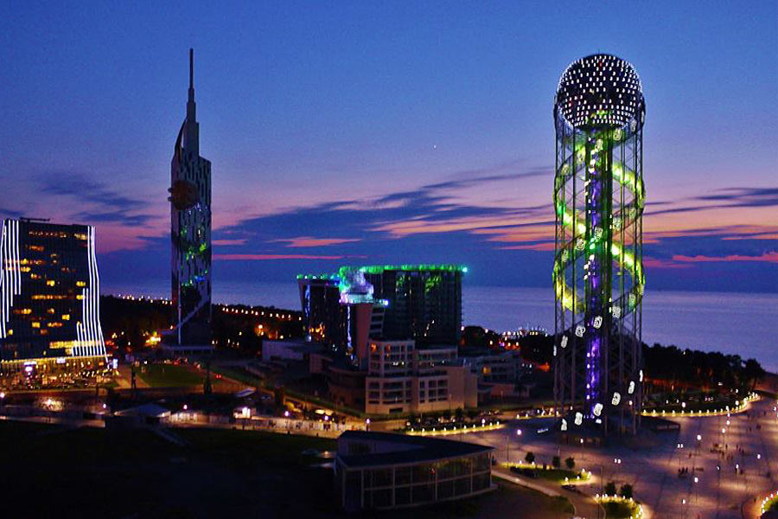
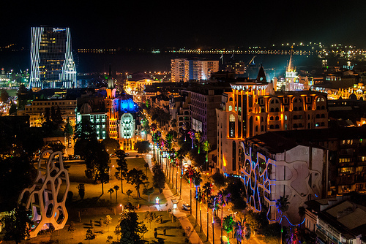
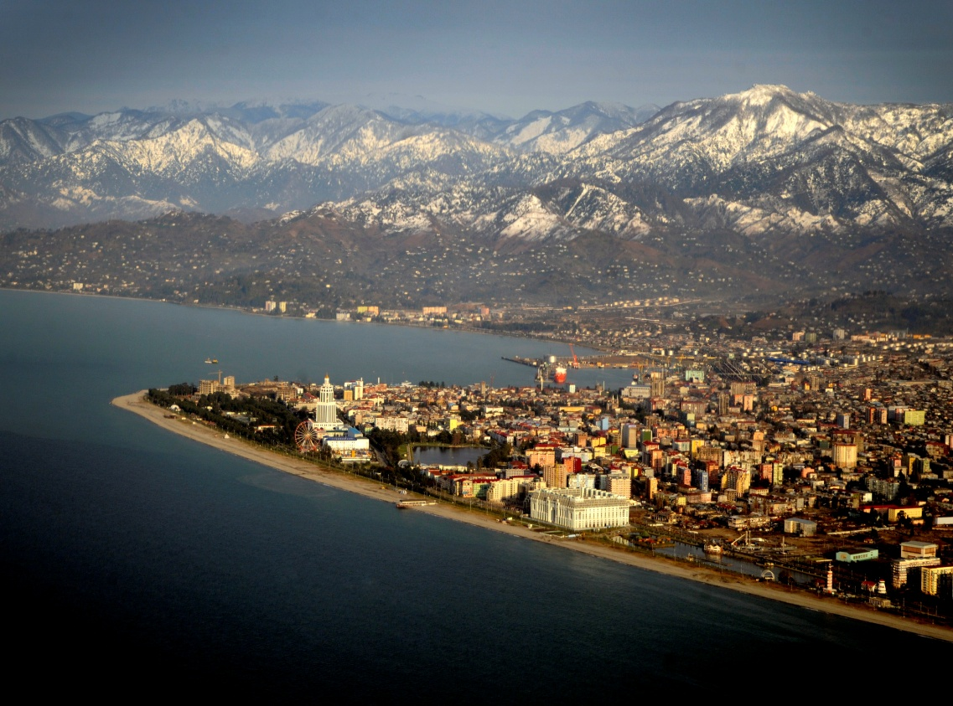
BATUMI

Slide 8
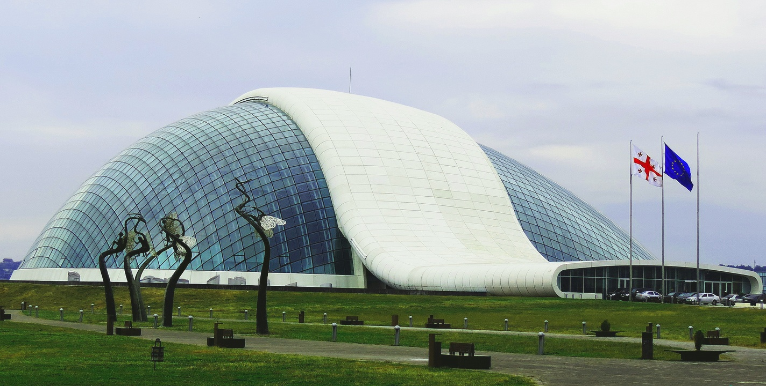
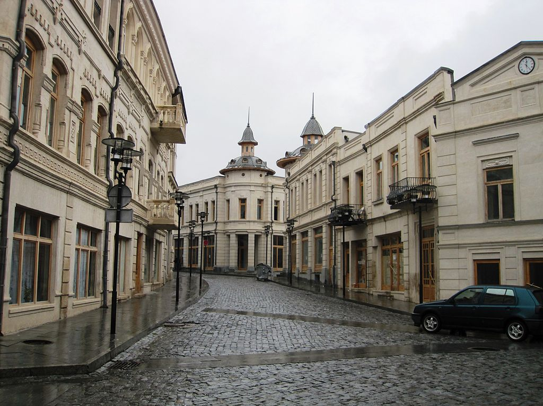
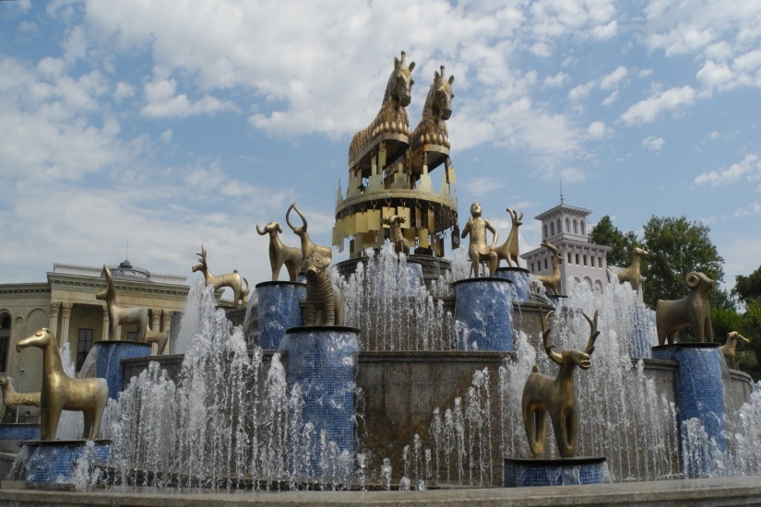
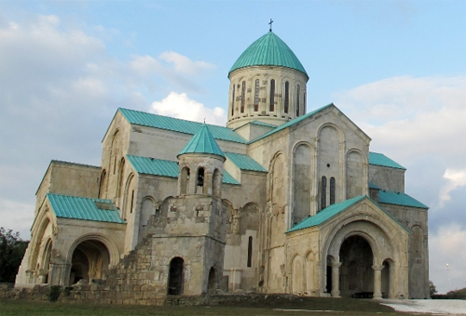
KUTAISI

Slide 9
What do you recall about Georgia?

Slide 10
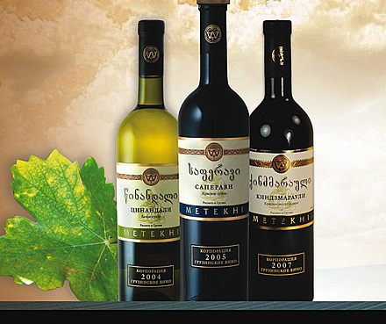
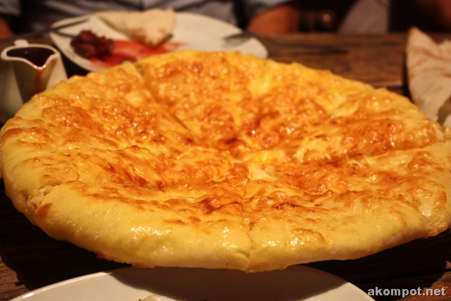
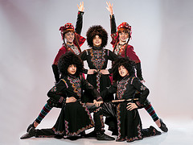
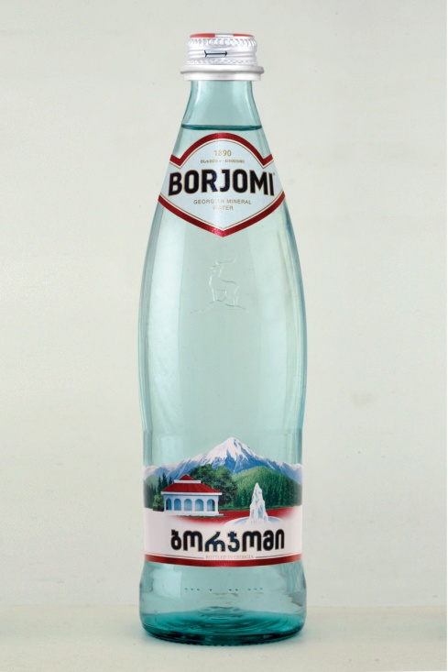
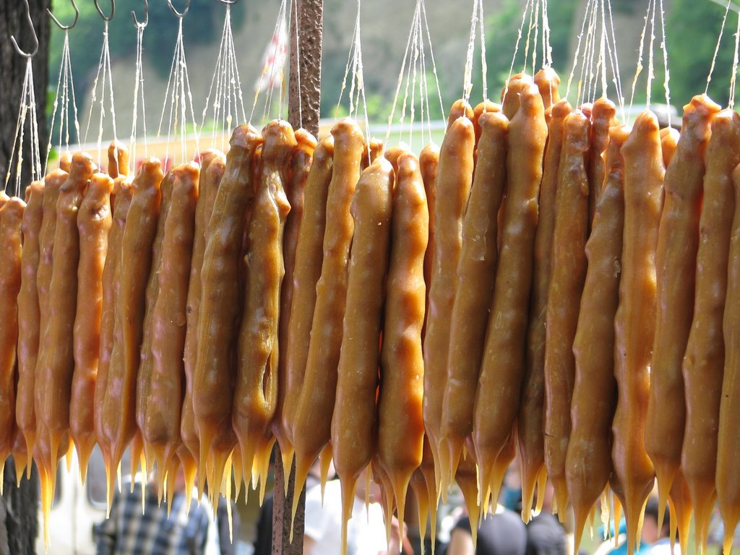
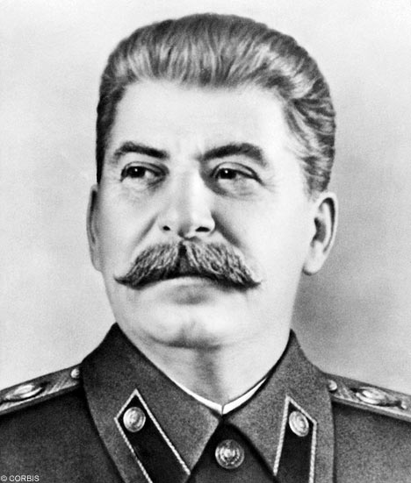
Georgia is famous for…

Slide 11
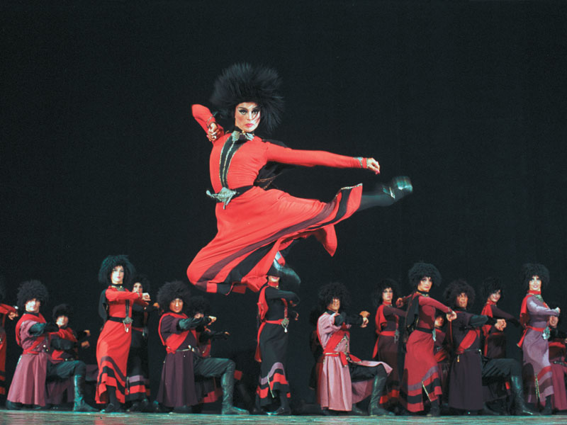
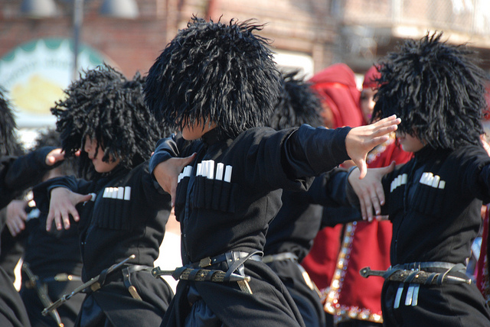
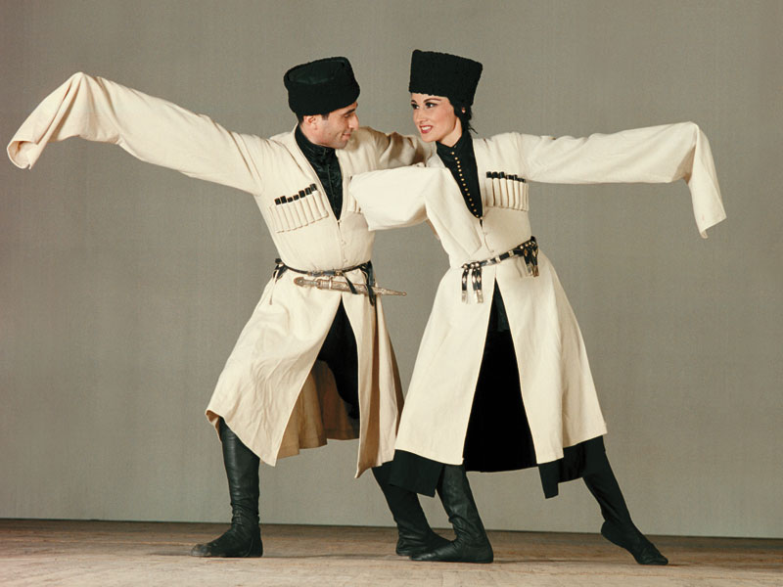
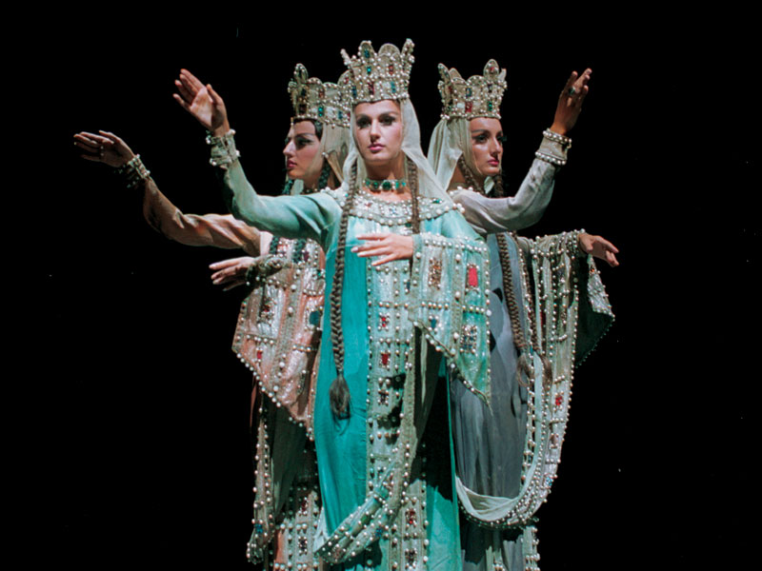
GEORGIAN DANCE

Slide 12
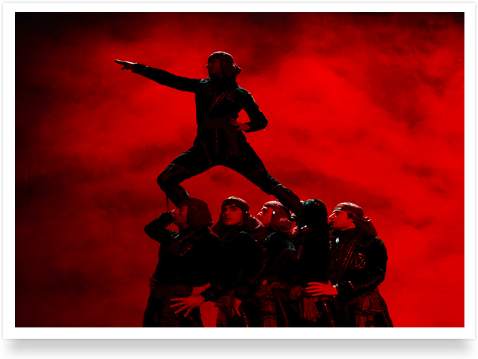
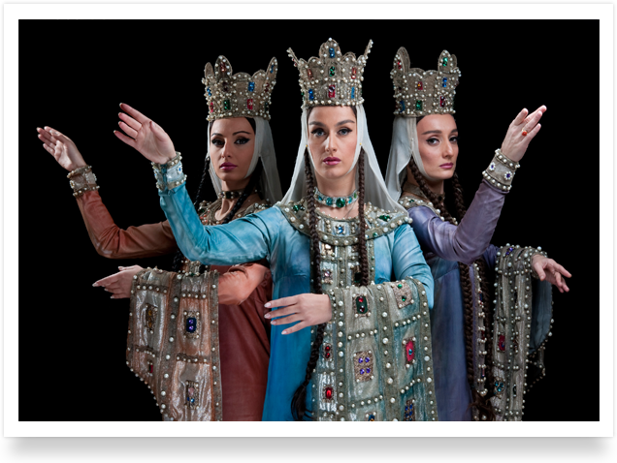
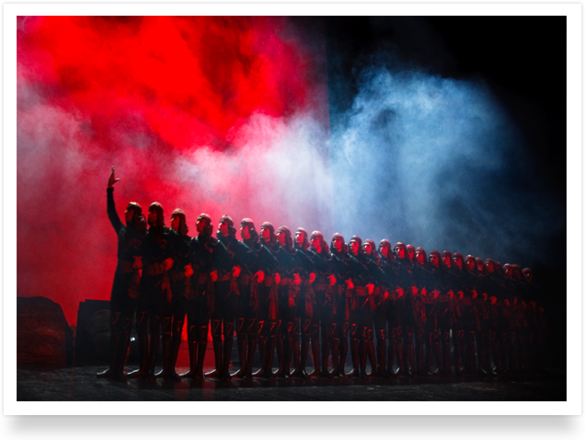
The Georgian National Ballet, Sukhishvili, was founded in 1945 and now it is very popular in the world.

Slide 13
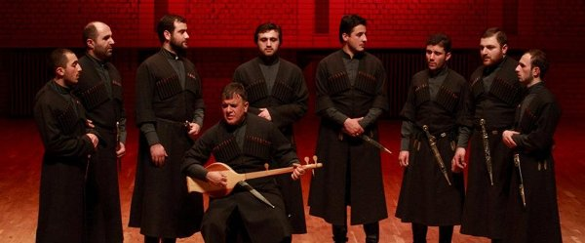
Music
The most well-known example of music in Kakhetian style is the patriotic "Chakrulo", which was chosen to accompany the Voyager spacecraft in 1977.

Slide 14
Cinema
“Georgian film is a completely unique phenomenon, vivid, philosophically inspiring, very wise, childlike. There is everything that can make me cry and I ought to say that it (my crying) is not an easy thing.”

Slide 15
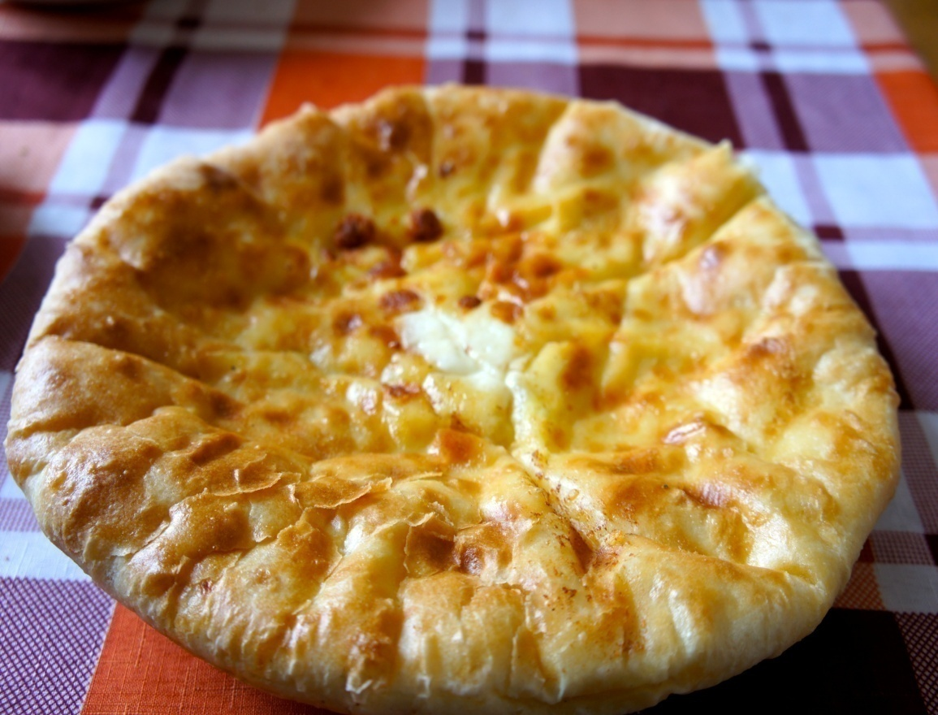
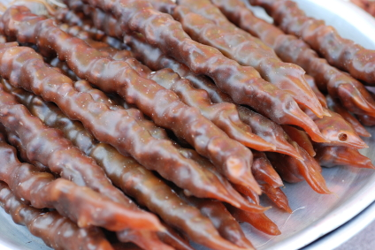
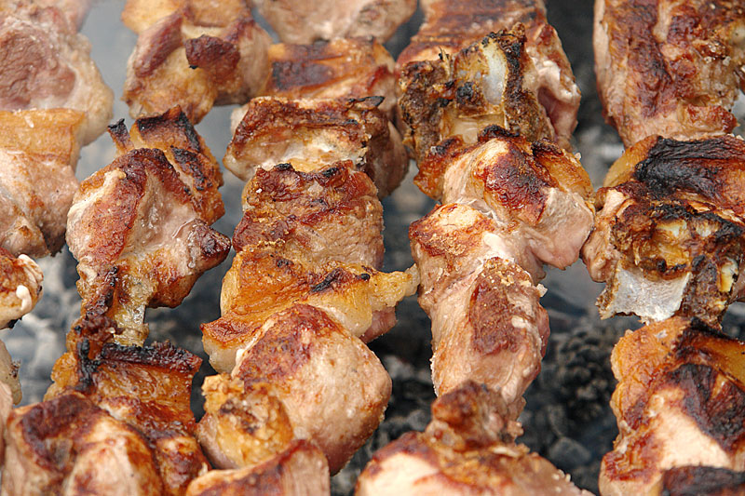
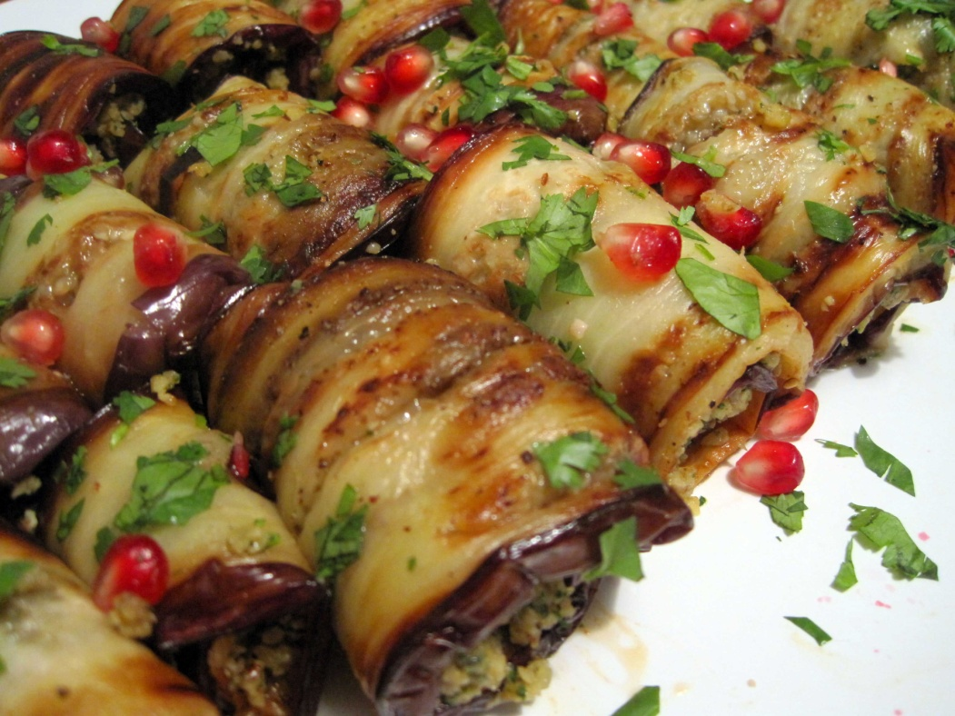
GEORGIAN CUISINE

Slide 16
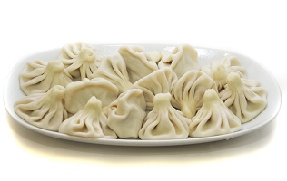
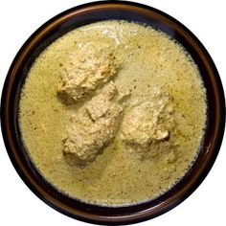
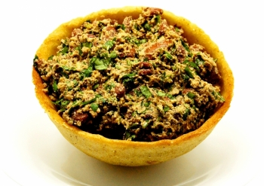
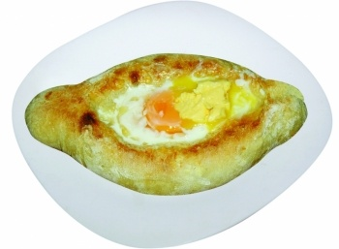
Top 5 Georgian Food

Slide 17
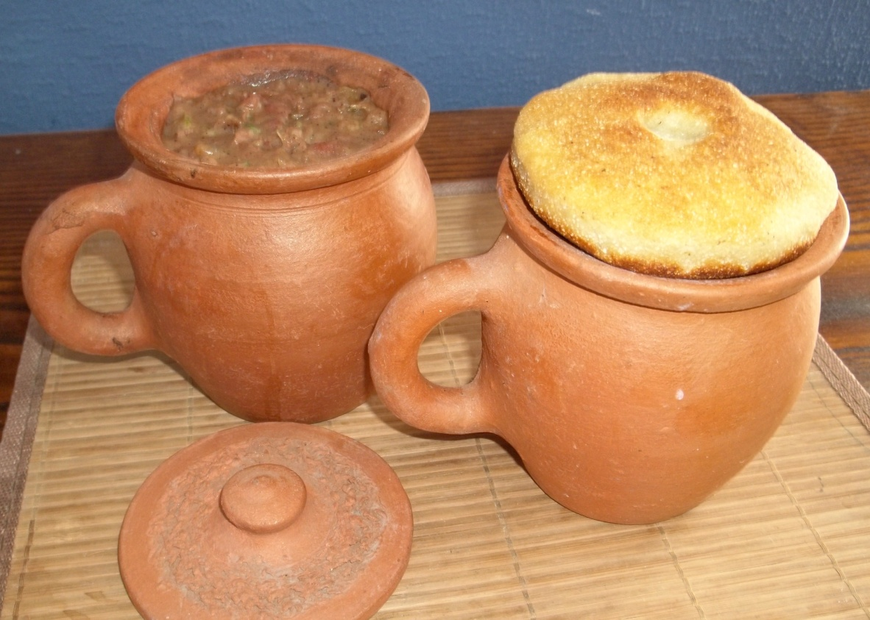
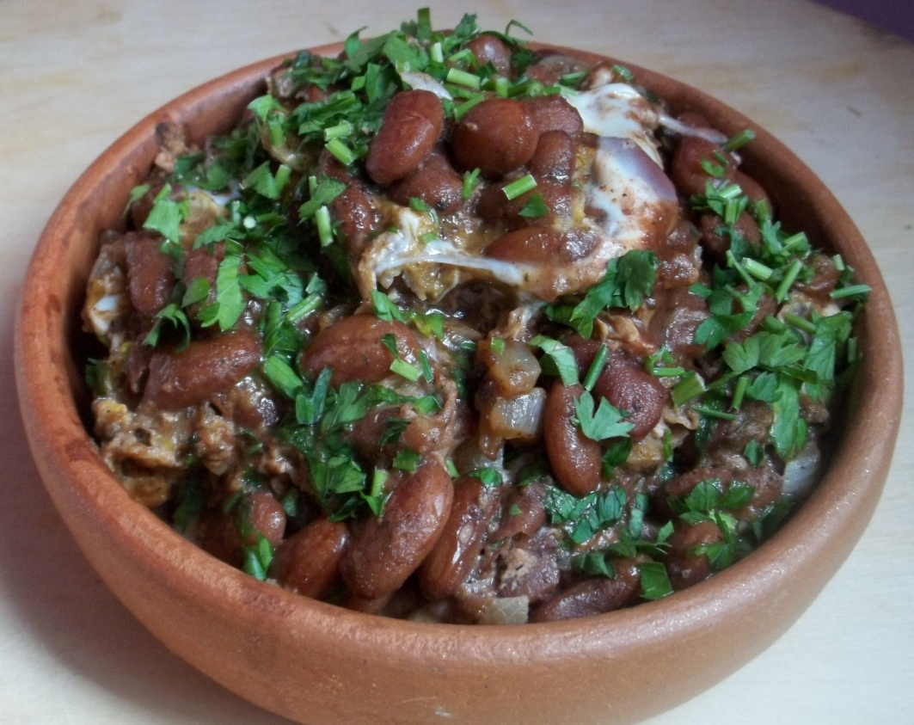
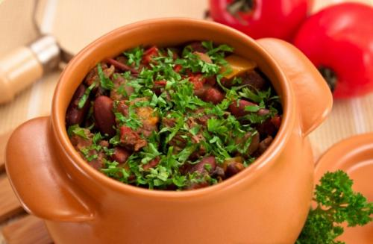
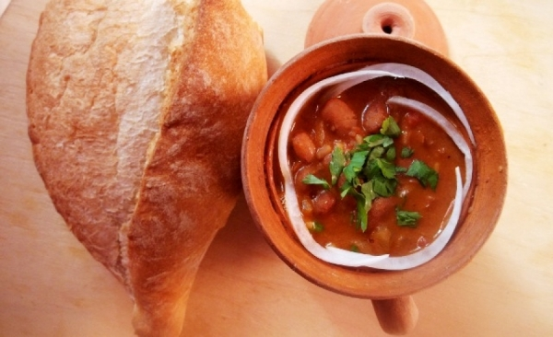
N5 Lobio (bean)

Slide 18
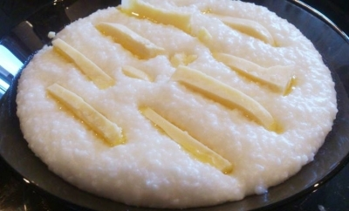
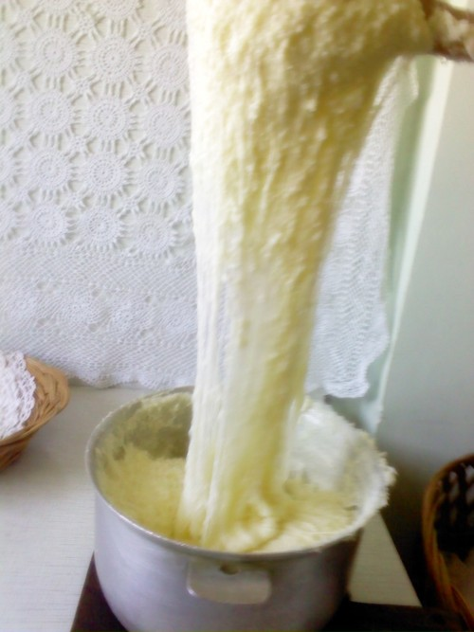
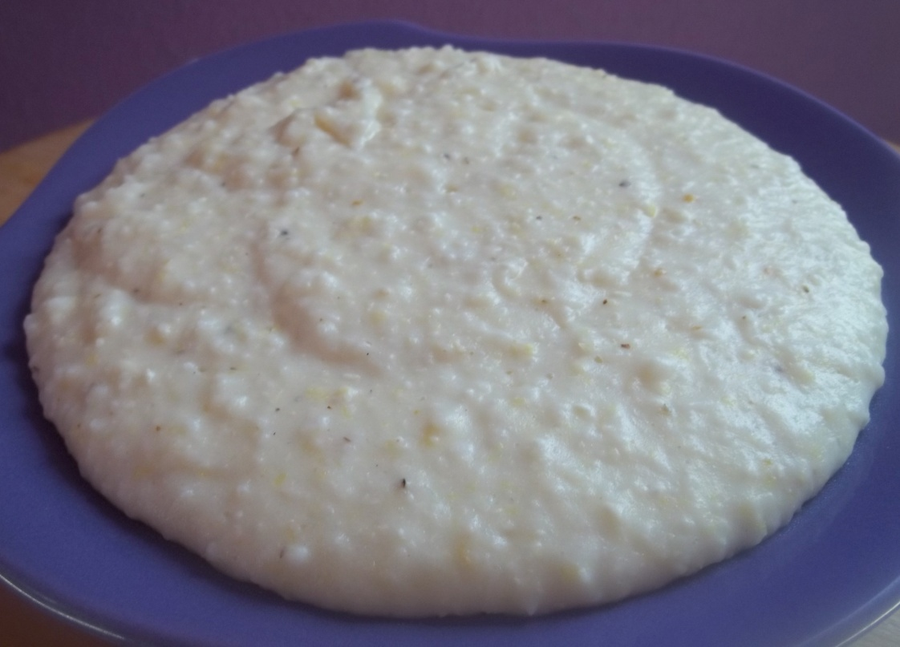
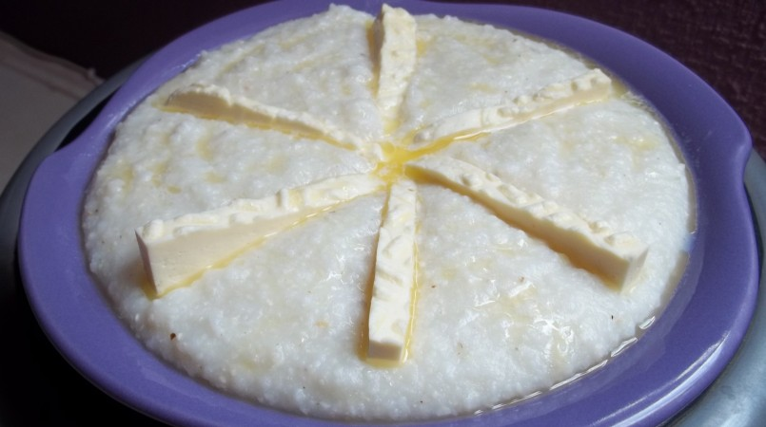
N4 Ghomi with cheese or Elarji

Slide 19
N3 Mtsvadi

Slide 20
N2 Khinkali

Slide 21
Guruli
Imeruli
N1 Khachapuri
Adjaruli
Megrelian

Slide 22
Georgian Beverages

Slide 23
Georgian Wine
Georgia is one of the most ancient wine-producing areas of the world, and its wines are popular around the world.
Wine is produced across the country, with the southeastern region of Kakheti making around 70%, in a wide selection of varieties.

Slide 24
Georgian Vodka – Chacha
Georgian vodka, chacha is actually distilled from the grape pomace left over after wine-pressing; however, it can also be produced from other fruits. Chacha is often home-made, with individual families. It is too strong, about 40%-70% of alcohol.

Slide 25
Georgian Candy

Slide 26
Churchkhela
One of the most popular desserts is this sausage-shaped candy, also popular in many of Georgia’s neighboring countries. It is prepared by threading walnuts onto a long string and dipping it in concentrated fresh grape juice, which dries into a gelatin-like coating around the nuts.

Slide 27
Gozinakhi
Gozinaki is a traditional candy during Christmas holidays. It is made by honey and nut.

Slide 28
Why should you visit Georgia?
Here you can find everything…

Slide 29
Sea

Slide 30
Mountains

Slide 31
Glacier

Slide 33
Desert

Slide 34
Canyons

Slide 40
Thanks For Attention!

