Slide 1

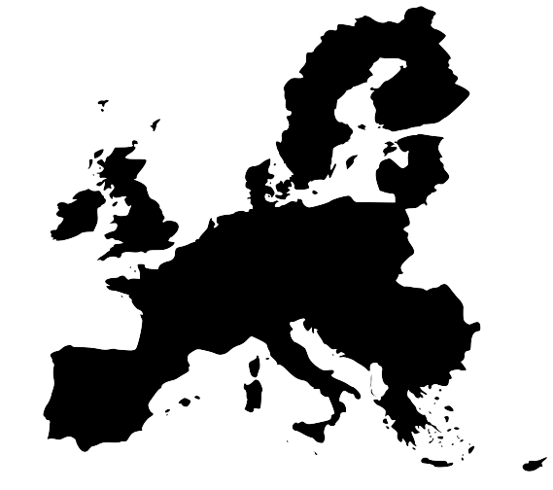
The case for Europe
Villa Decius
July 2015
Jonathan Holslag
Vrije Universiteit Brussel

Slide 2
I. The crisis
II. The world
III. The dilemma
IV. The answer

Slide 3

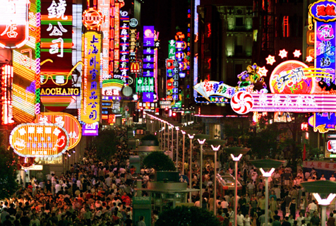
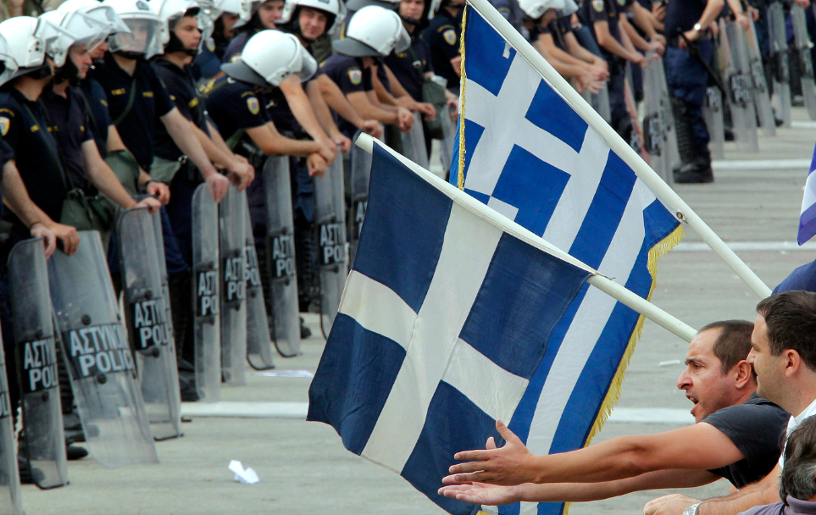
I. The crisis

Slide 4
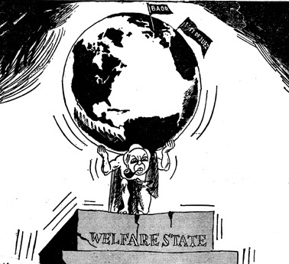
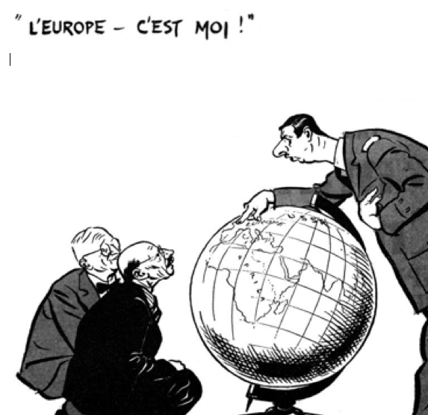
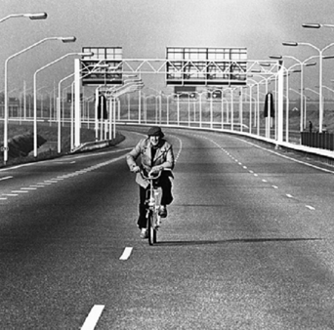

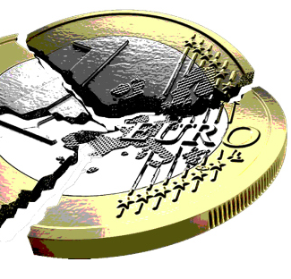
I. The crisis
The four lives of Europe
John F. Dulles, 1956: “Europe is tired, worn out and almost willing to buy peace.”
The New York Times, 1966: “Europe is plunging into anarchy.”
The Economist,1974: “Europe has settled into a state of dejection and disarray.”
The Times, 1992: “Europe could follow the Soviet Union.”

Slide 5
I. The crisis
This crisis is different
1. The crisis of European politics
2. The crisis of the pragmatic politician
3. The crisis of the welfare state
4. The crisis of the European economy – the balance of power

Slide 6

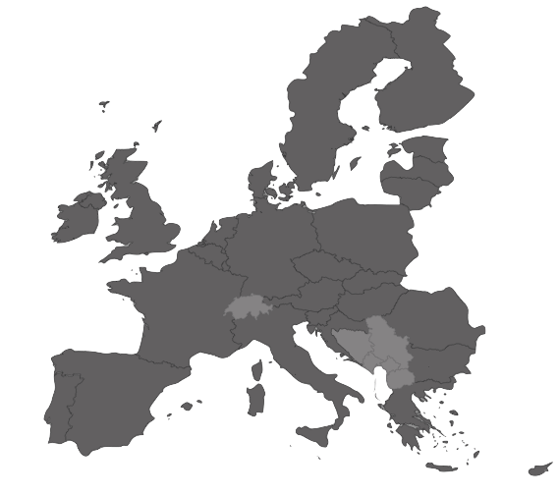
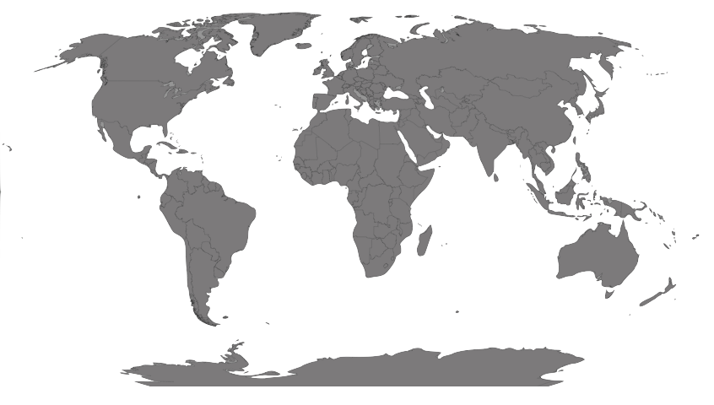


I. The crisis
Layers of uncertainty
1. The world
2. Europe
3. The state
4. Society
5. Citizenship

Slide 7
II. The world
The penthatlon for power
1. Economic power politics
2. Resources
3. International organizations
4. Military
5. Europe’s gun powder moment

Slide 8
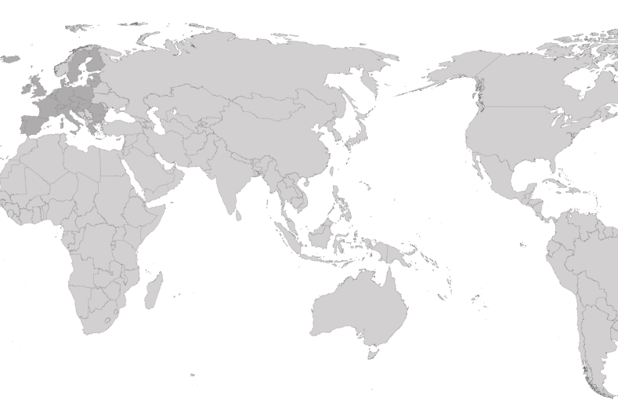
II. The world
1. Heartland
Rusland
2. Periphery
Turkije
3. Arc of disquiet
Iran
S.Arabië
4. Wedge of hardship
5. The rivals

Slide 9

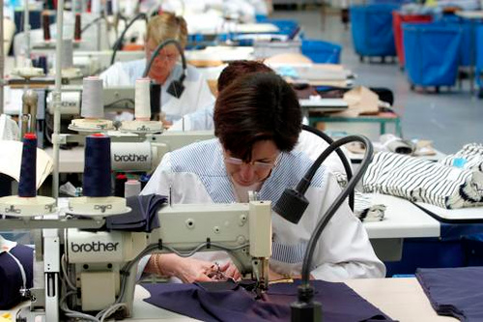
III. The dilemma

Slide 10
IV. The power of paradise
1. Hard military power
2. Diplomacy
3. Economy
4. Citizenship

